Slide 1
Complexity: horror incertii or gaudium novi?
Matthias Kaiser
Centre for the Study of the Sciences and Humanities, University of Bergen

Slide 2
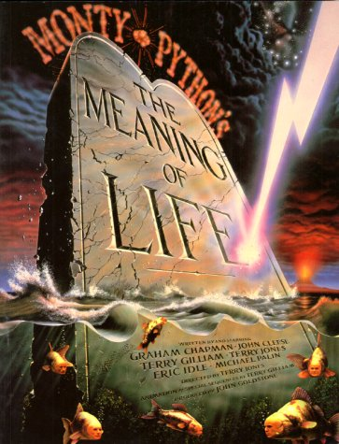

Question:
Is complexity a name we give to an epistemic enterprise when we have reached the borderlines of an established, well-known framework of thinking and face an apparent messy reality: the abyss of uncertainty to some, and the promise of a new start to others?

Slide 3
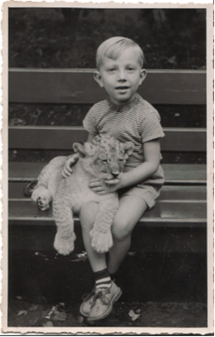
A personal narrative
Playing around with lions?

Slide 4
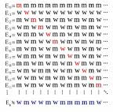
Logic: The ways of paradox are the ways to truth?
Let R = {x|x∉x}, then R∈R ⇔R∉R
“An analysis of the paradoxes to be avoided shows that they all result from a kind of vicious circle. The vicious circles in question arise from supposing that a collection of objects may contain members which can only be defined by means of the collection as a whole.” (Russell & Whitehead 1910:37)
They wanted certainty, instead they found uncertainty.

Slide 5
Solution?
What price classical logic?
Or restricting the concepts that I am allowed to form?
On an ad hoc basis?
In any case consequential: Gödel, fixed points

Slide 6
…onwards to philosophical logic
E.g. modal, epistemic, causal, deontic logics.
Impressive formalisms.
Non-standard semantics:
Possible worlds semantics!
But that works only with rigid designators
Why?
Substituvity of identity!
Hesperus = Phosporus ? = Venus? = the brightest planet in the evening?
Singular descriptions versus names?

Slide 7
Something x is essentially something y and accidentally something else?
Metaphysics
Meanings (singular descriptions) open up uncertainties.
Are we discovering the nature of our terms or are we imposing a regiment on our terms for the sake of a system we know?
Do we need to presuppose causality in order to explain the logic of causality?

Slide 8
… onwards to understanding scientific theories
What changes and what remains in a scientific revolution?
From Wegener’s Continental Drift (1912) to plate tectonics (ca 1967):
Hanson’s challenge: the descriptions of the experiental parts of our theories presuppose the theory itself (theory-infectedness).
Describing the parts presupposes the whole?

Slide 9
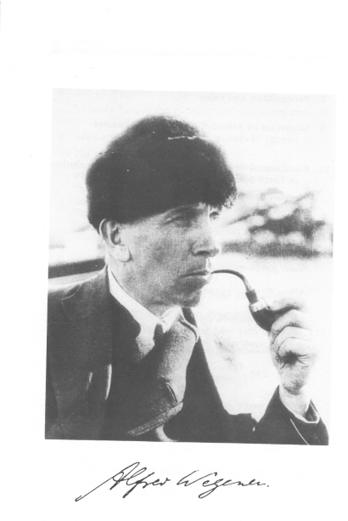
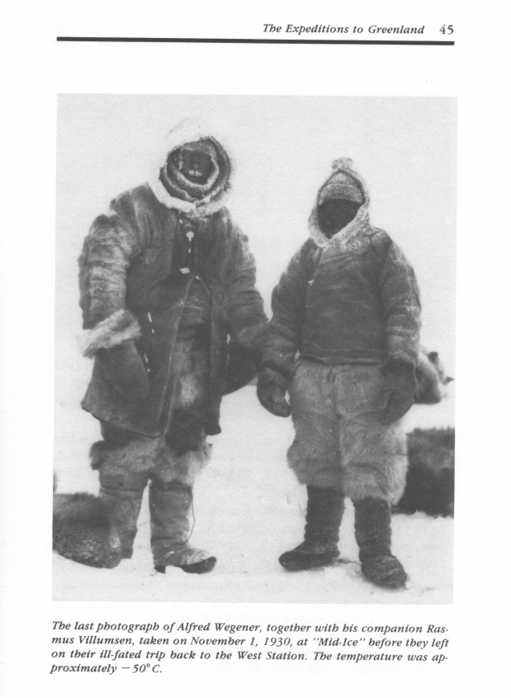
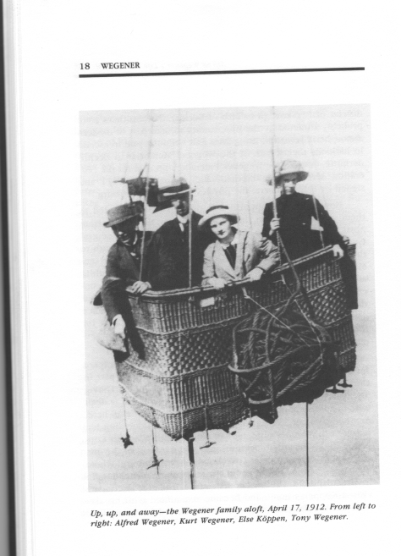
An example: From Continental Drift to Plate Tectonics.
Alfred Wegener – an outsider with a popular idea.

Slide 10
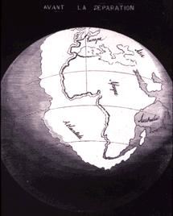
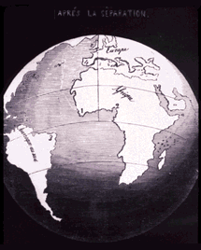
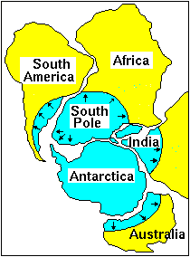
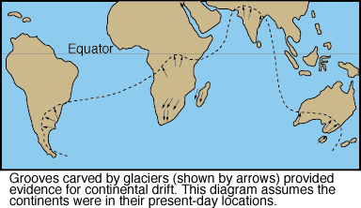
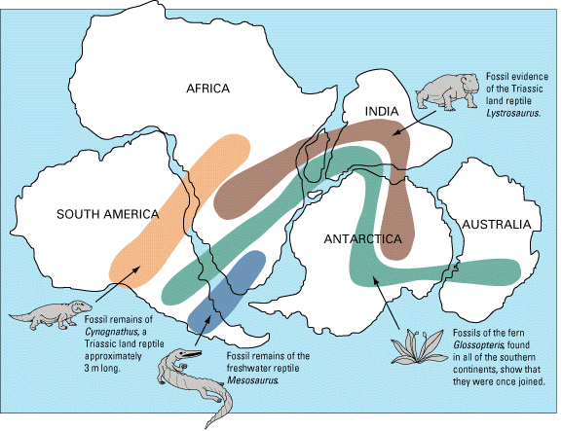

Slide 11
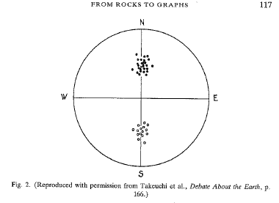
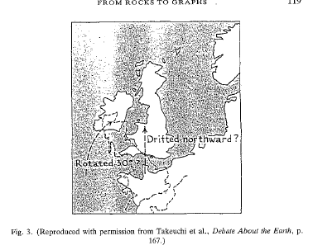

Slide 12
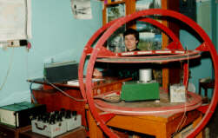
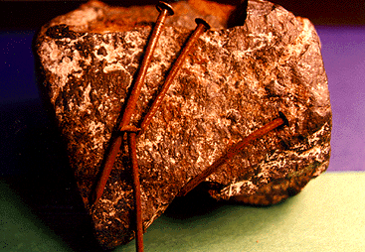
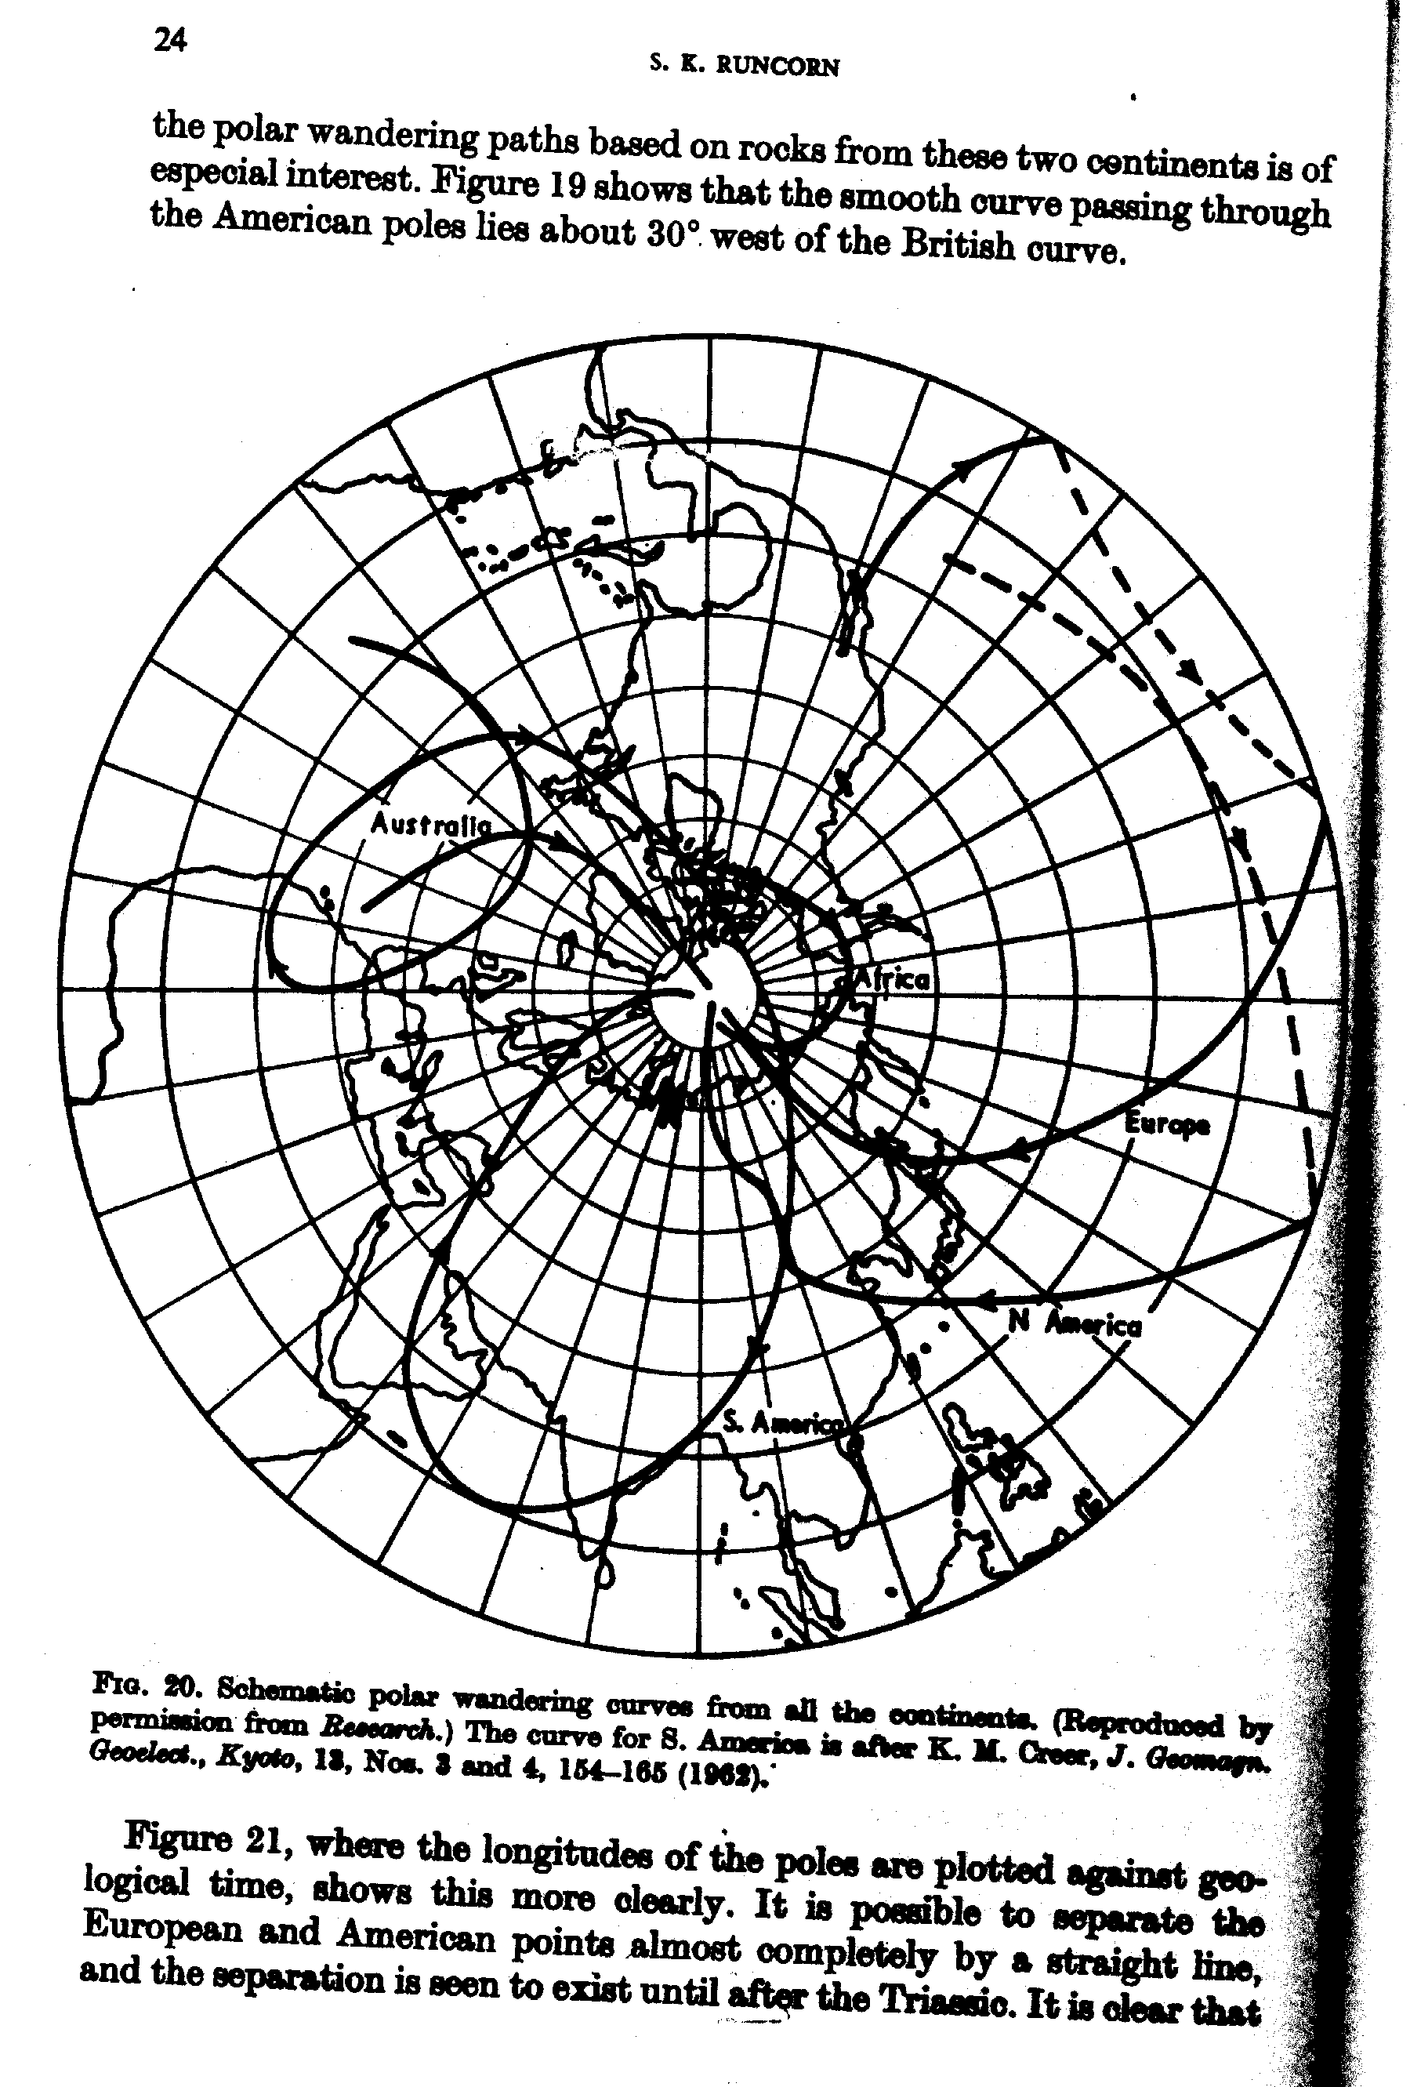

Slide 13
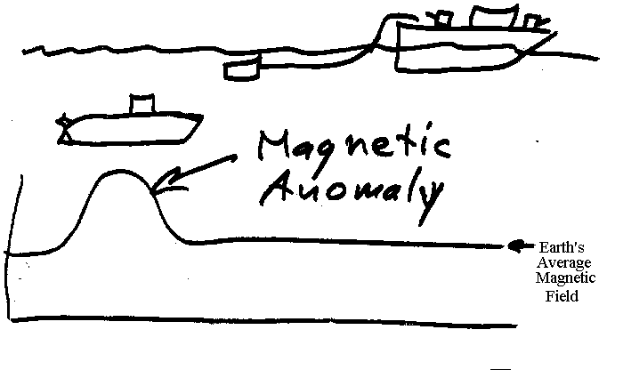

Slide 14
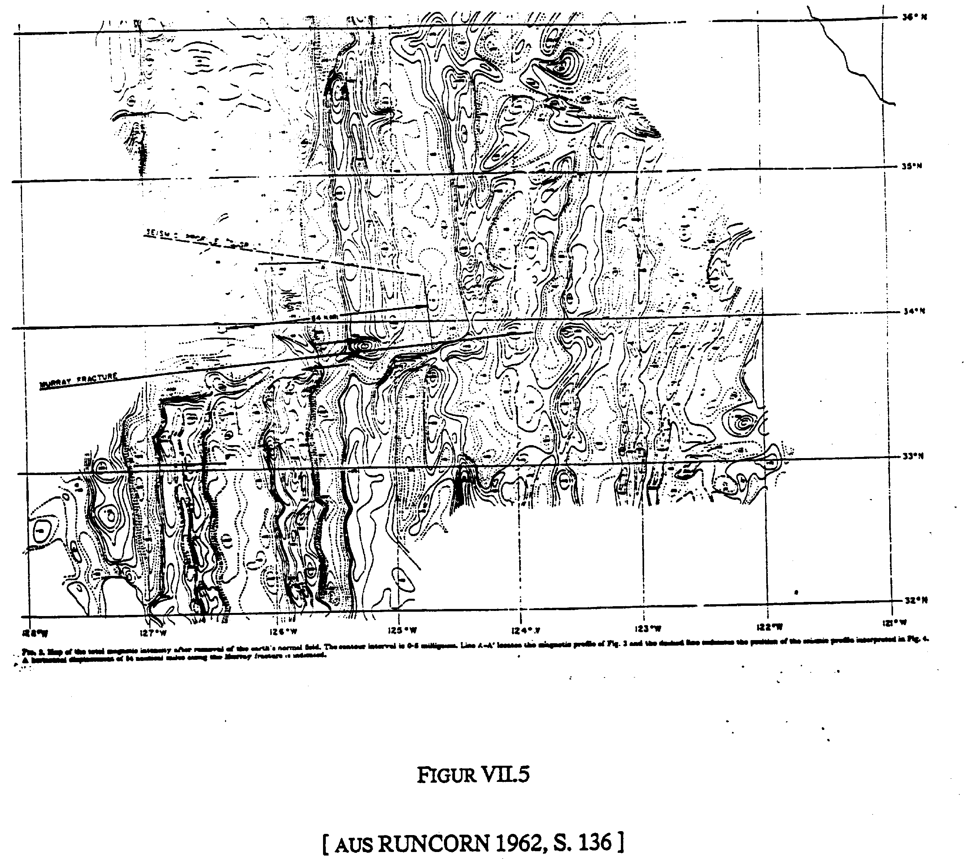


Slide 15
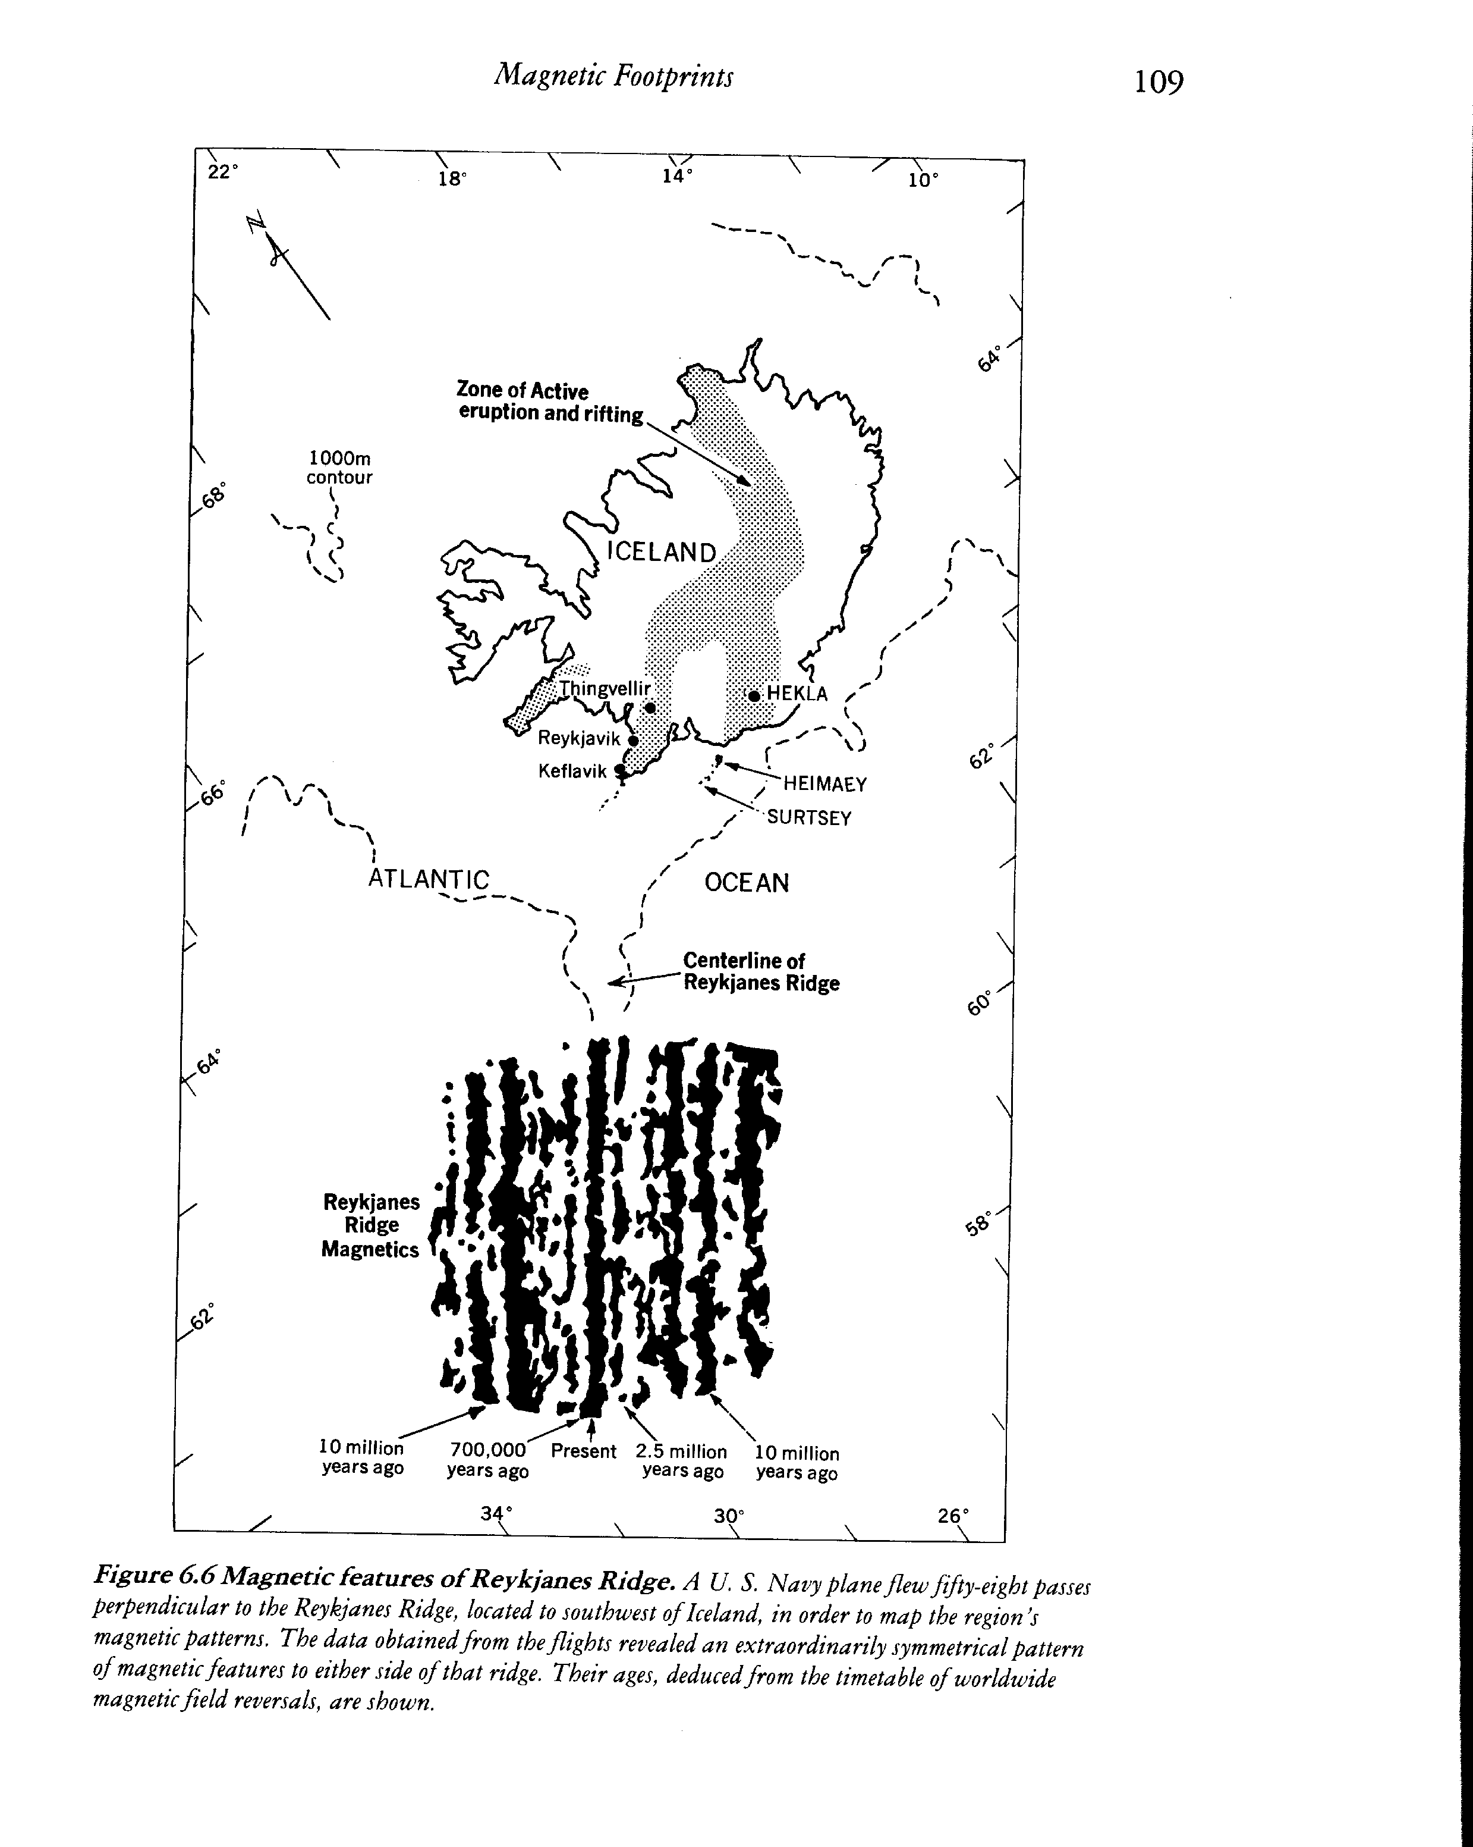
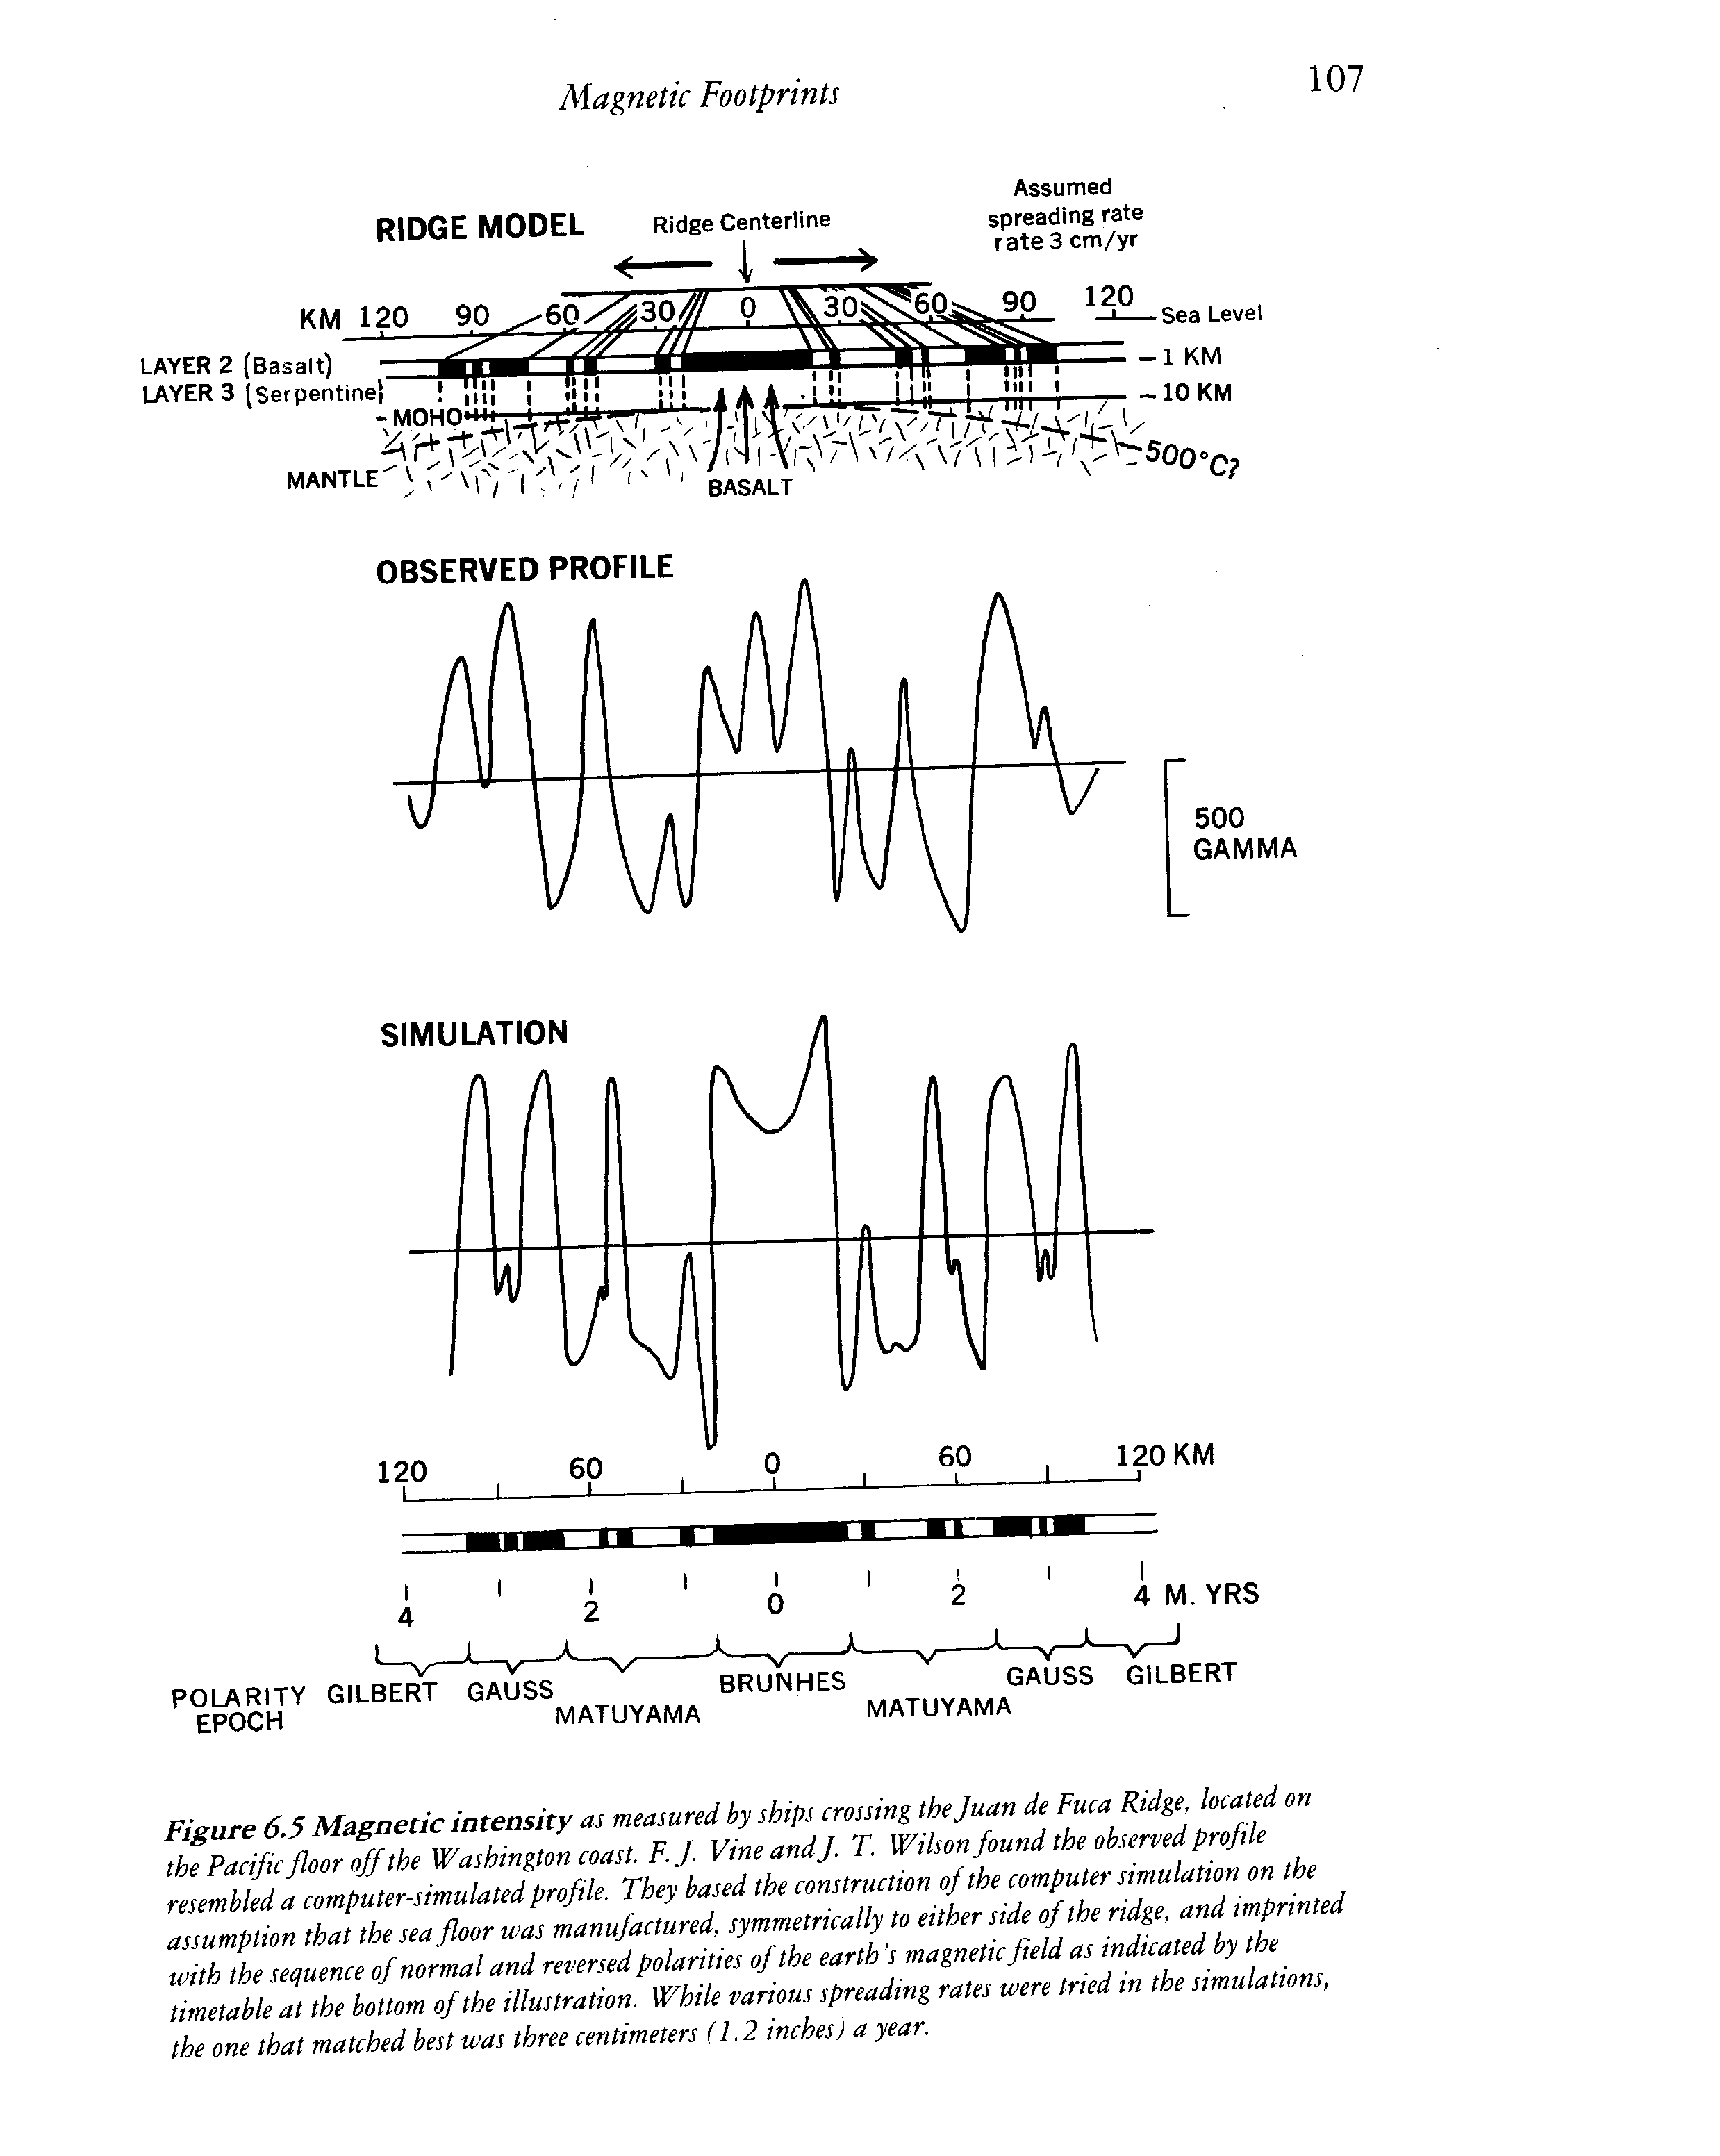

Slide 16
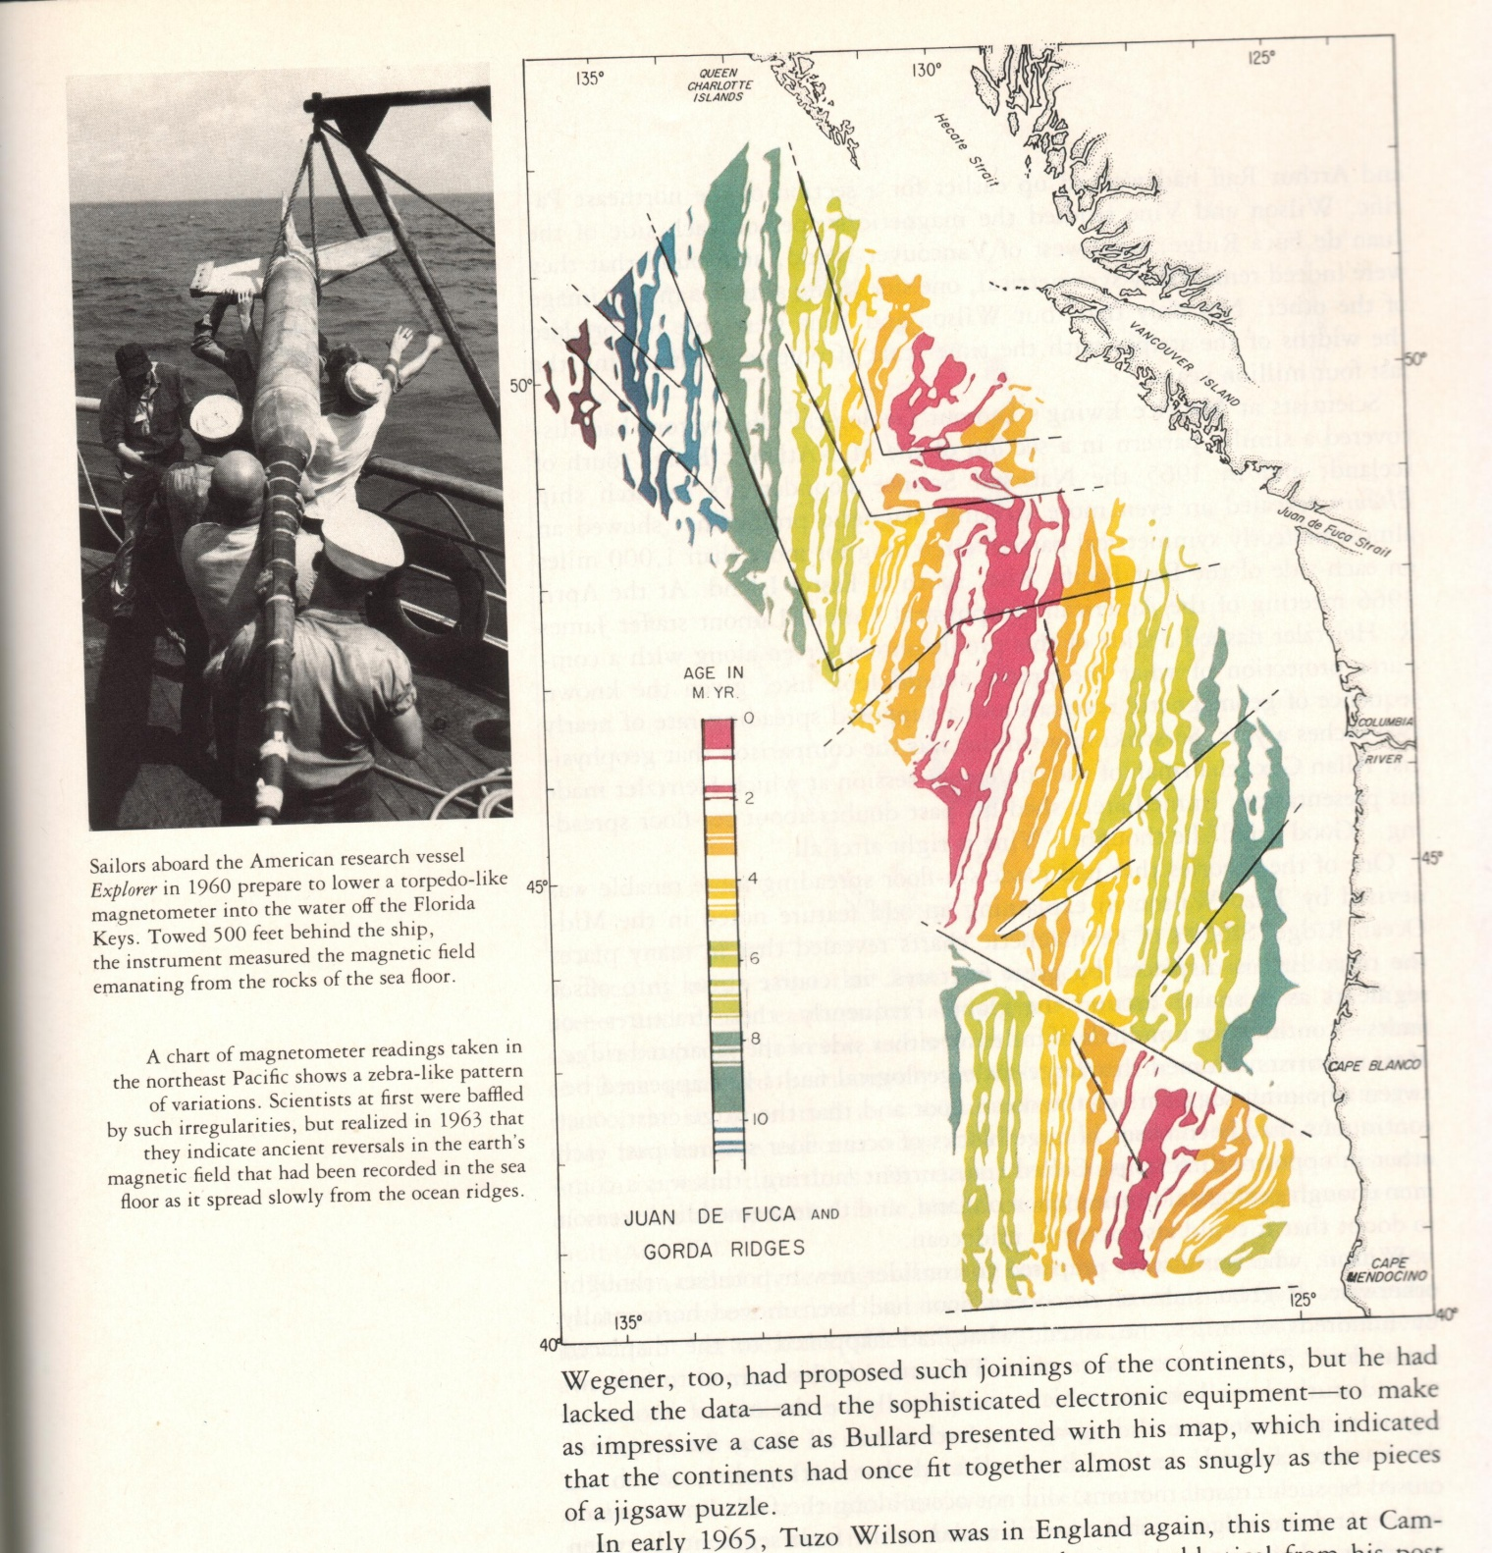

Slide 17
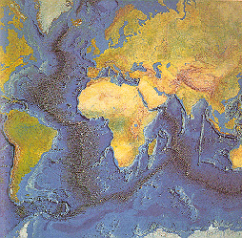
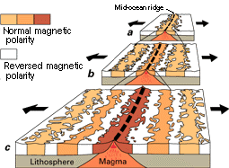

Slide 18
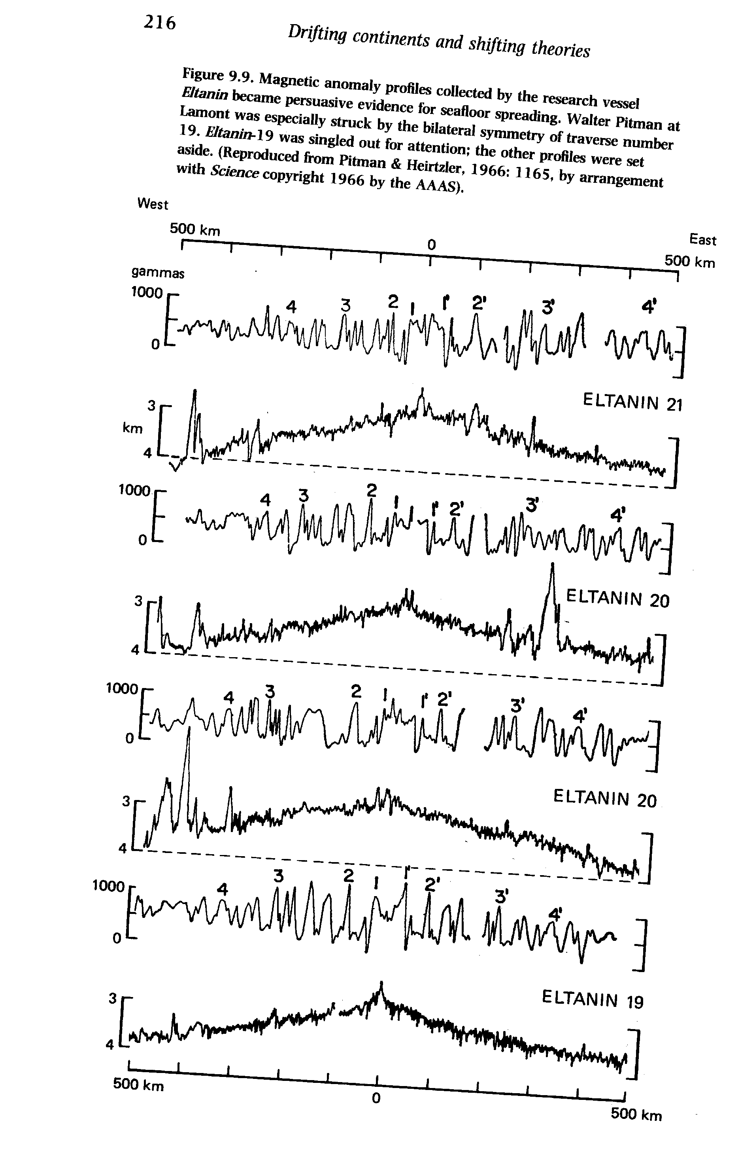
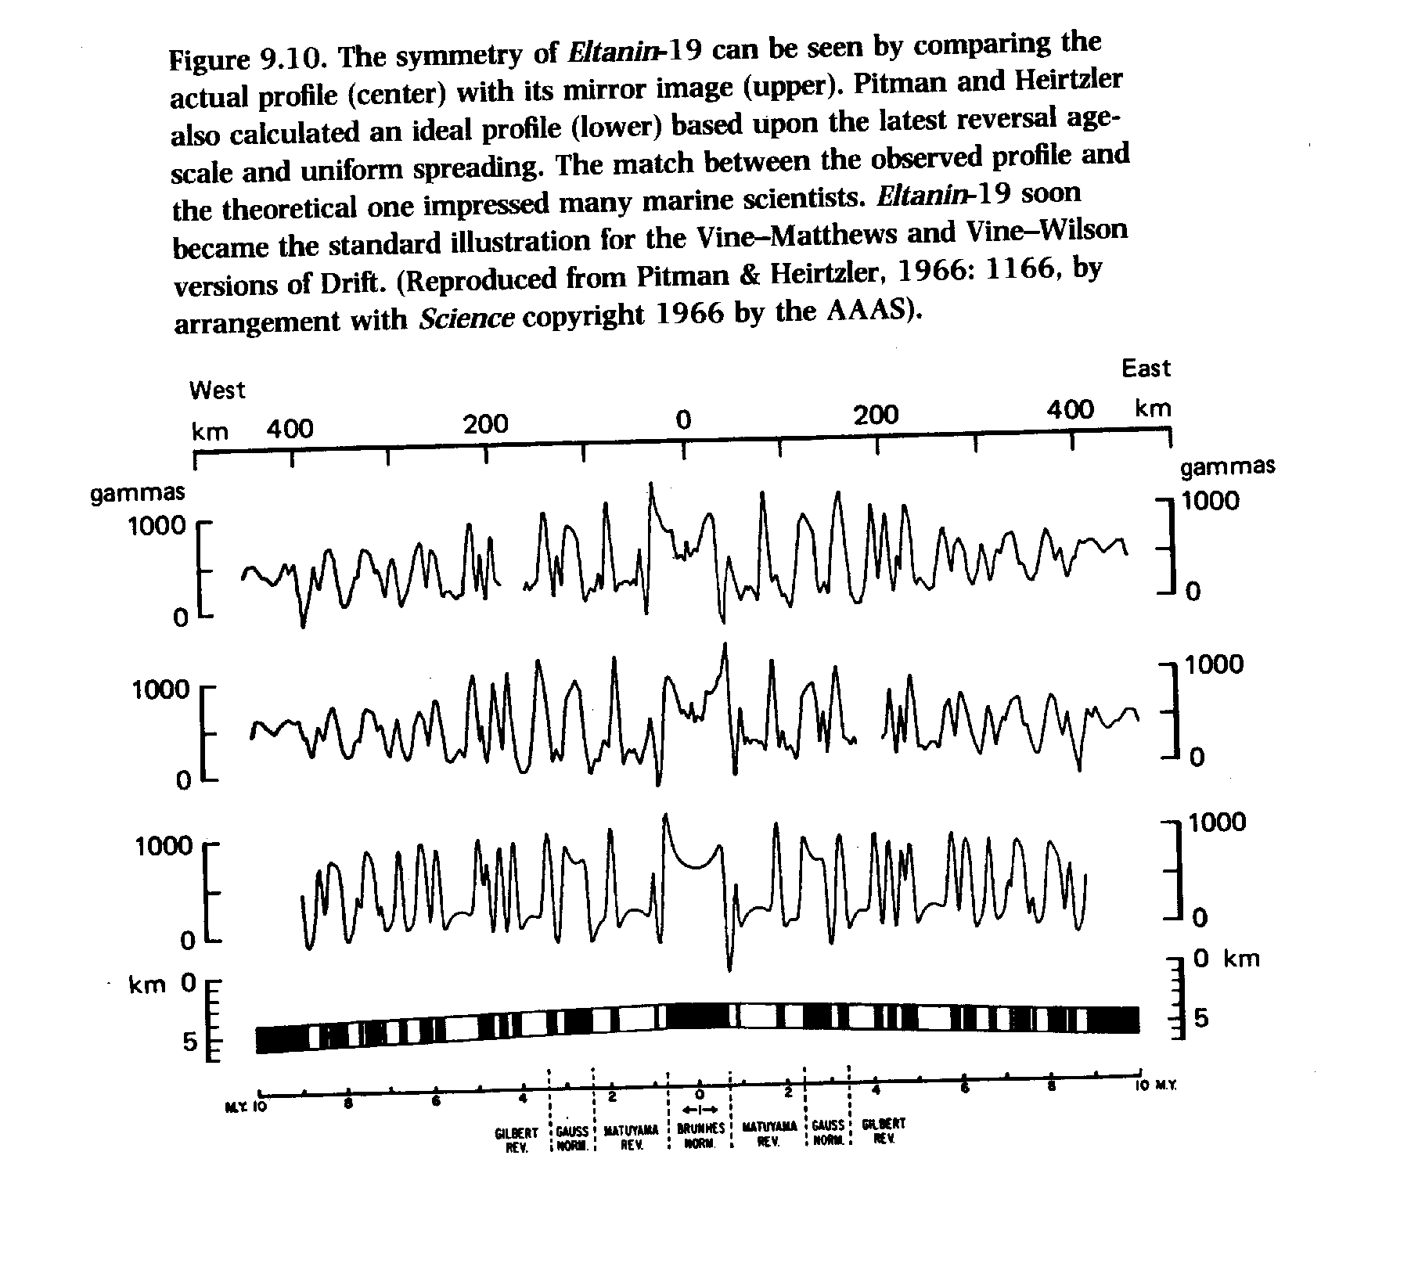

Slide 19
How I conceive of science:
Not two, but three basic units: theories, phenomena, and data
Theories are families of models
Phenomena are the objects of theories
Data are the foundation of phenomena
Not deductive model of statements, but rather structural representation
Has an ”inductive” step from data to phenomena
Has a ”deductive” or subsumptive element from theory to phenomena.
Theory
Phenomena
match
stepwise abstraction
Data

Slide 20
”Our theories are simply not designed to deal with complex singularities, but rather with simple generalities” (Kaiser 1995).
Abstraction / idealization towards phenomena involves re-descriptions that decide what to count as noise and what as signal.
Once we have discarded the noise, the theories cannot ”reach back” to the complexity of the singularities.
Basic science ≠ applied science

Slide 21

Science celebrates order, because reality is so messy?
If phenomena and models are based on abstractions, then this implies purpose and delineation.
The map of science does not fold neatly over reality; rather a patchwork?

Slide 22
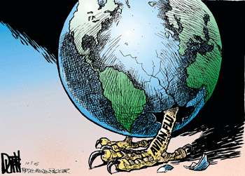
…onwards to technology assessment and risks
The changing culture of risk:

Slide 23
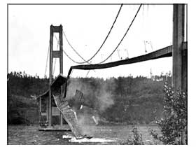
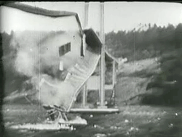
1: Risk as engineering error: ”Galloping Gertie” Tacoma Narrows Bridge 1940

Slide 24
Engineering error:
Problem:
Overlooking variables in nature
Distance from theoretical model to real system
Solution:
Safety margins to be built in

Slide 25

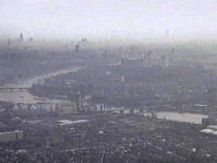
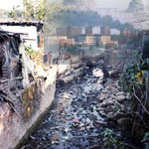
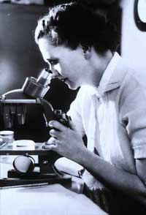
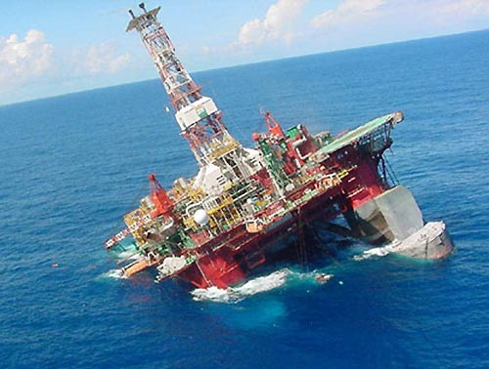
1.a The unseen risks: ”There is poison all around us now” The New York Times, review av Silent Spring

Slide 26
”Unseen risks”
Problem:
Frightening for large parts of the public
Detection often too late?
Solution:
Scientific risk assessment (regulated)
Trustworthy communication

Slide 27
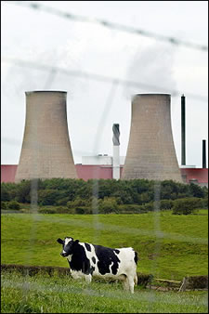
2: Risk as consequence of Big (Frightening) Technology: Nuclear Power

Slide 28
Big Technology risk
Problem:
Possible harm not localized to cause of risk
Complex technological system with multiple causal pathways
Population perceives risks as large; resistance
Solution:
Risk analysis
Safety measures / Protection standards
Countermeasures and restoration
Scientific education of people / decision-makers

Slide 29
In social science:
Ulrich Beck, Risikogesellschaft (”Risk society”) 1986
Kristin Shrader-Frechette, Risk Analysis and Scientific Method, 1985

Slide 30
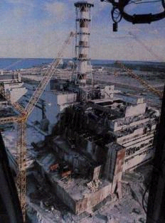
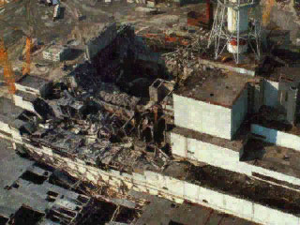
Chernobyl shows reality of risk:

Slide 31
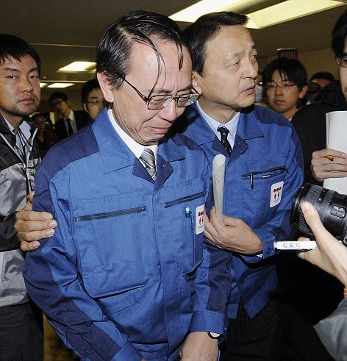
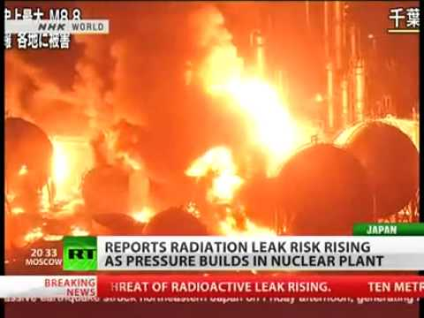
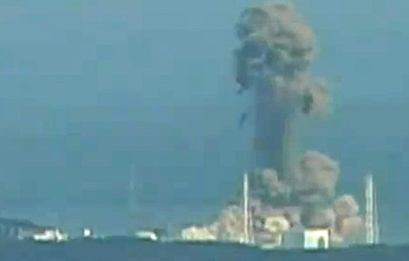
… and recently: Fukushima !

Slide 32
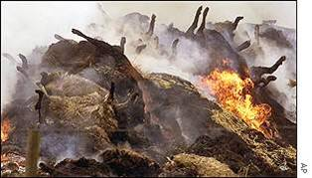
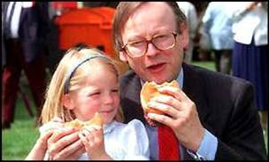
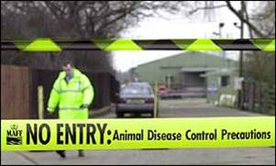
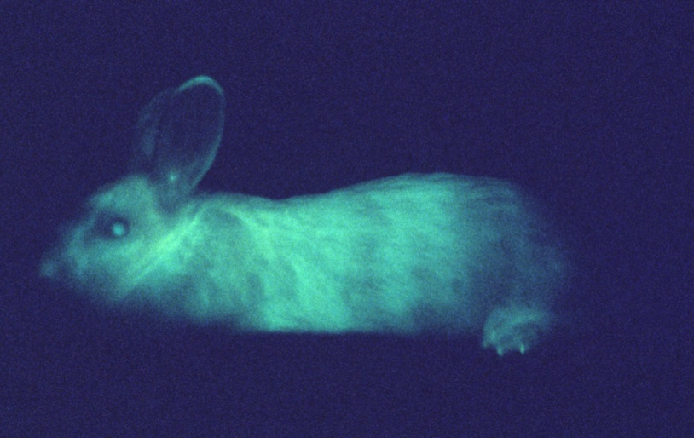
2 a: Risk, biotechnology, and modern agriculture

Slide 33
Big ”bio”-technology risk
Problem:
Similar to Big Technology risk
Causal pathways via biological material
Fear factor large;
Solution:
Biosafety assessments and measures
Containment as far as possible
Consumer information & choice

Slide 34
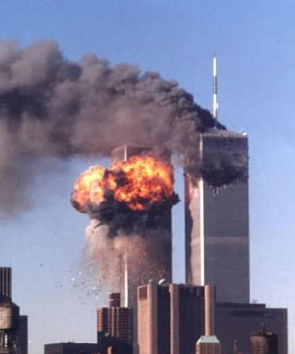
3: Incalculable risk: 9/11

Slide 35
Incalculable risks:
Problem:
”outrageous events”, human behaviour
Politics involved
Solution:
Security measures aimed at preventing outrageous events to occur
International cooperation

Slide 36

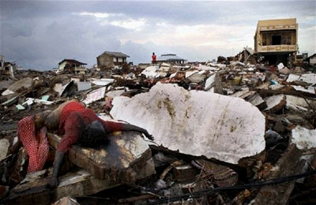
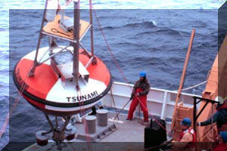
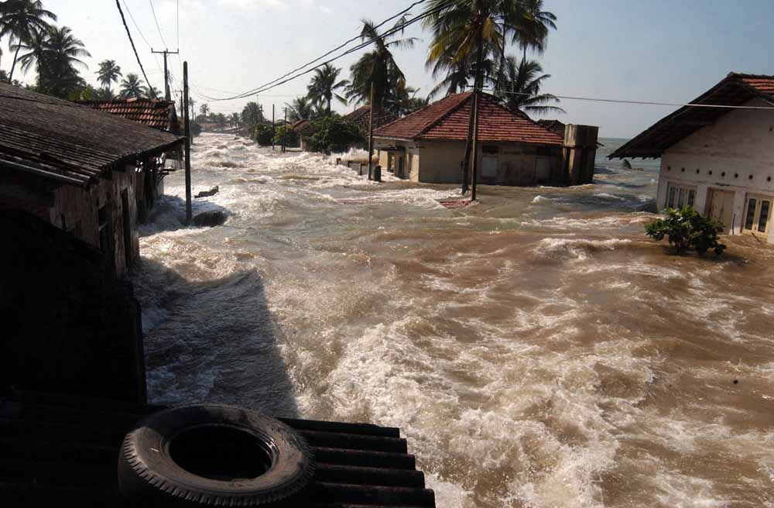
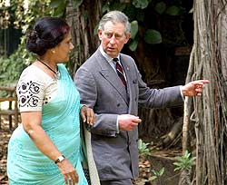
4: Risk as co-extension between nature, society, and technology: Tsunami 2004

Slide 37
Co-extension of nature, society and technology risks:
Problem:
Dimensions of possible harm vary with complex conditions prior to risk cause and with abatement measures
Solution:
Precautionary measures
All-encompassing security

Slide 38
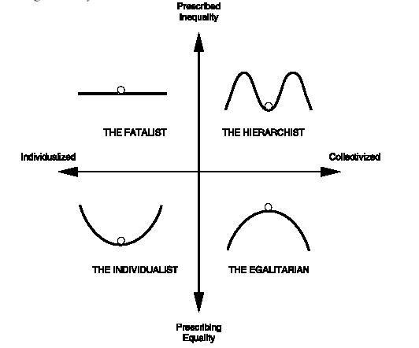
Risk willingness vs risk avoidance
Depending on perceived qualities of risks
Depending on individual characteristics
Depending on what the individual believes about nature or society:

Slide 39
Risk is a social construct.
Risk abatements tend to transform risks rather than to eliminate them.
Assumed systems tend to hide uncertainties and values that influence their construction.
Scientific assessments tend to provide a cloud of certainty where maps of uncertainty would make a difference.
Complexity at the bottom or excuse for the lack of control?

Slide 40
…onward to managing uncertainties in life
The illusion of science-based objective decision making.
Sustainability transcends science.

Slide 41
UNESCO World Commission on the Ethics of Scientific Knowledge and Technology (COMEST) Expert Group Precautionary Principle
to clarify the PP for decision makers and scientists in order to achieve a more informed debate of the principle and to serve as reference for possible further implementation of PP to present recommendations on how PP can contribute to a sustainable future.

Slide 42
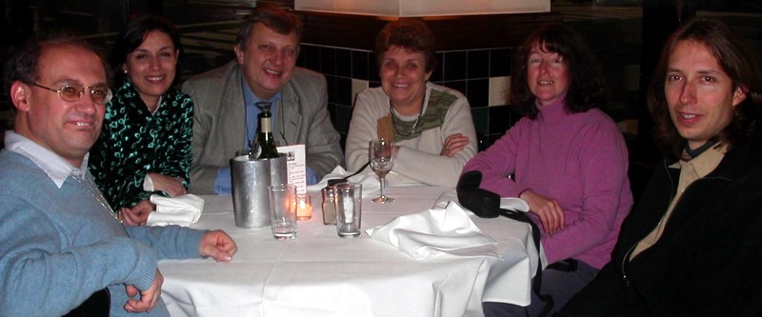
Expert Group members
Matthias Kaiser (Philosopher), NENT, Oslo, Norway. (Chair)
Jeroen van der Sluijs (Associate Professor), Copernicus Institute UU & C3ED UVSQ (Rapporteur)
Sharon Beder (Professor), School of Social Sciences, Media and Communication,University of Wollongong, Australia.
Vittorio Hösle (Philosopher), Department of Philosophy, University of Notre Dame, Notre Dame, USA.
Aída Kemelmajer de Carlucci (Judge, Supreme Court), Mendoza, Argentina.
Ann Kinzig (Assistant Professor), School of Life Sciences, Arizona State University, Tempe, USA.

Slide 43
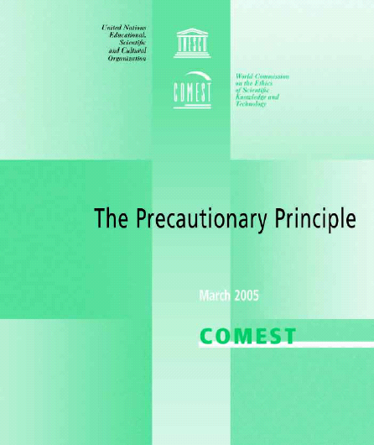
Available in English, French, Spanish , Arabic, Chinese. UNESCO – COMEST, 2005, The Precautionary Principle, Report, UNESCO: Paris, see also http://unesdoc.unesco.org/images/0013/001395/139578e.pdf; Download also via link: www.jvds.nl

Slide 44
New working definition UNESCO
When human activities may lead to morally unacceptable harm that is scientifically plausible but uncertain, actions shall be taken to avoid or diminish that harm.

Slide 45
When human activities may lead to morally unacceptable harm that is scientifically plausible but uncertain, actions shall be taken to avoid or diminish that harm.
Morally unacceptable harm refers to harm to humans or the environment that is
threatening to human life or health, or
serious and effectively irreversible, or
inequitable to present or future generations, or
imposed without adequate consideration of the human rights of those affected.
The judgment of plausibility should be grounded in scientific analysis. Analysis should be ongoing so that chosen actions are subject to review.
Uncertainty may apply to, but need not be limited to, causality or the bounds of the possible harm.
Actions are interventions that are undertaken before harm occurs that seek to avoid or diminish the harm. Actions should be chosen that are proportional to the seriousness of the potential harm, with consideration of their positive and negative consequences, and with an assessment of the moral implications of both action and inaction. The choice of action should be the result of a participatory process.

Slide 46
When human activities may lead to morally unacceptable harm that is scientifically plausible but uncertain, actions shall be taken to avoid or diminish that harm.
Morally unacceptable harm refers to harm to humans or the environment that is
threatening to human life or health, or
serious and effectively irreversible, or
inequitable to present or future generations, or
imposed without adequate consideration of the human rights of those affected.
The judgment of plausibility should be grounded in scientific analysis. Analysis should be ongoing so that chosen actions are subject to review.
Uncertainty may apply to, but need not be limited to, causality or the bounds of the possible harm.
Actions are interventions that are undertaken before harm occurs that seek to avoid or diminish the harm. Actions should be chosen that are proportional to the seriousness of the potential harm, with consideration of their positive and negative consequences, and with an assessment of the moral implications of both action and inaction. The choice of action should be the result of a participatory process.

Slide 47
When human activities may lead to morally unacceptable harm that is scientifically plausible but uncertain, actions shall be taken to avoid or diminish that harm.
Morally unacceptable harm refers to harm to humans or the environment that is
threatening to human life or health, or
serious and effectively irreversible, or
inequitable to present or future generations, or
imposed without adequate consideration of the human rights of those affected.
The judgment of plausibility should be grounded in scientific analysis. Analysis should be ongoing so that chosen actions are subject to review.
Uncertainty may apply to, but need not be limited to, causality or the bounds of the possible harm.
Actions are interventions that are undertaken before harm occurs that seek to avoid or diminish the harm. Actions should be chosen that are proportional to the seriousness of the potential harm, with consideration of their positive and negative consequences, and with an assessment of the moral implications of both action and inaction. The choice of action should be the result of a participatory process.

Slide 48
When human activities may lead to morally unacceptable harm that is scientifically plausible but uncertain, actions shall be taken to avoid or diminish that harm.
Morally unacceptable harm refers to harm to humans or the environment that is
threatening to human life or health, or
serious and effectively irreversible, or
inequitable to present or future generations, or
imposed without adequate consideration of the human rights of those affected.
The judgment of plausibility should be grounded in scientific analysis. Analysis should be ongoing so that chosen actions are subject to review.
Uncertainty may apply to, but need not be limited to, causality or the bounds of the possible harm.
Actions are interventions that are undertaken before harm occurs that seek to avoid or diminish the harm. Actions should be chosen that are proportional to the seriousness of the potential harm, with consideration of their positive and negative consequences, and with an assessment of the moral implications of both action and inaction. The choice of action should be the result of a participatory process.

Slide 49
The PP:
Acknowledges the ”complex world of decision making” (?)
Calls for knowledge quality assessment
Extends the ”peer-group” outside science.

Slide 50
Conclusions:
”Gaudium novi”?
Perhaps we should play with lions and seek to construct radically new orders and frameworks for our thinking. Neither concepts nor theories nor categories or principles are holy; they are but our tools for life.
”Horror incertii”?
But we should not fall prey for the illusions of objectivity and neglect our moral responsibility for the values and uncertainties with which we have infected our representations of reality .

