Slide 1
An Exploration of the Ethics of Using Land to Produce Non-Food Biomass for Energy
Orla Shortall.
University of Nottingham and University of Copenhagen.
Supervisors: Dr. Kate Millar Centre for Applied Bioethics, University of Nottingham, Dr.Sujatha Raman Institute for Science and Society, University of Nottingham,
Prof. Peter Sandoe Faculty of Life Sciences, University of Copenhagen, Dr. Christian Gamborg Faculty of Life Sciences, University of Copenhagen.

Slide 2
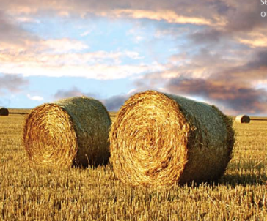

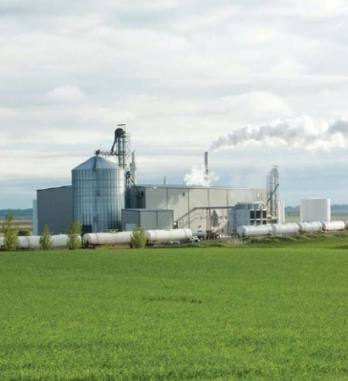
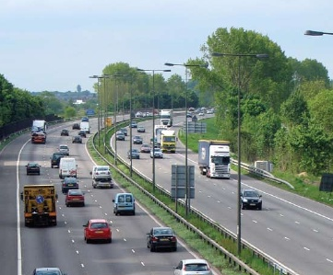
Introduction
Background
Interests
Methodology
Empirical work

Slide 3
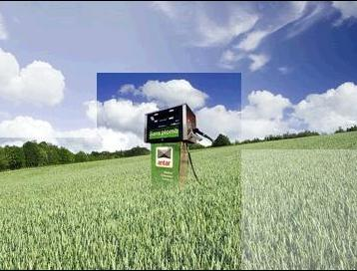
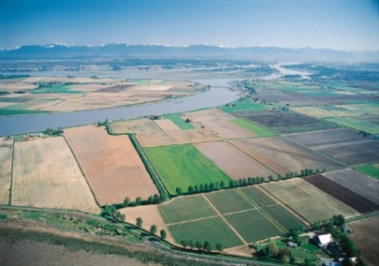
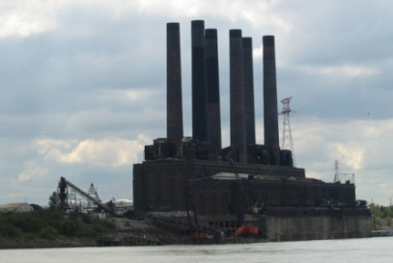
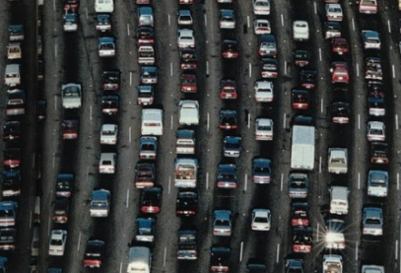
Introduction
What is biomass energy?
Biomass: living or recently living matter.
Biomass energy: any energy derived form biomass.
Bioenergy: electricity or heat produced from biomass.
Biofuels: liquid fuel used in the transport sector. Currently food crops – corn, sugarcane, palm oil etc.

Slide 4
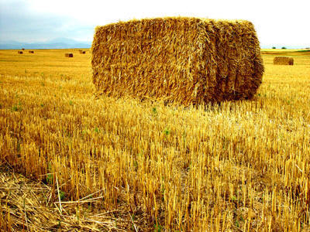
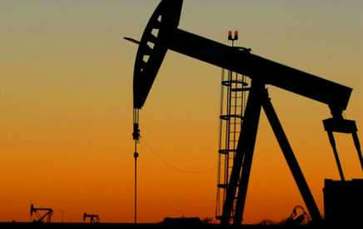
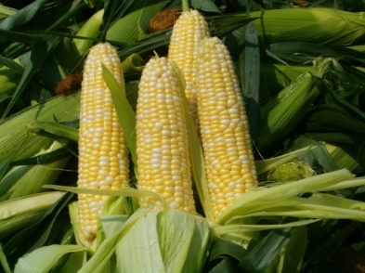
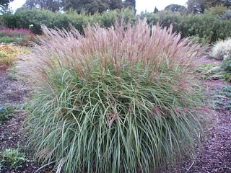
Introduction
Post-normal science
High uncertainty: epistemological, ethical.
High stakes: environmental.
Make values explicit and manage uncertainty. Funtowicz, S.O. and Ravetz, J.R. (1993) “Science for the Post-Normal Age” Future (3): 739-755
Project: comparative study UK and Denmark. Make values explicit in debates about bioenergy governance.
Examine framing of debate.
Conduct ethical analysis.

Slide 5
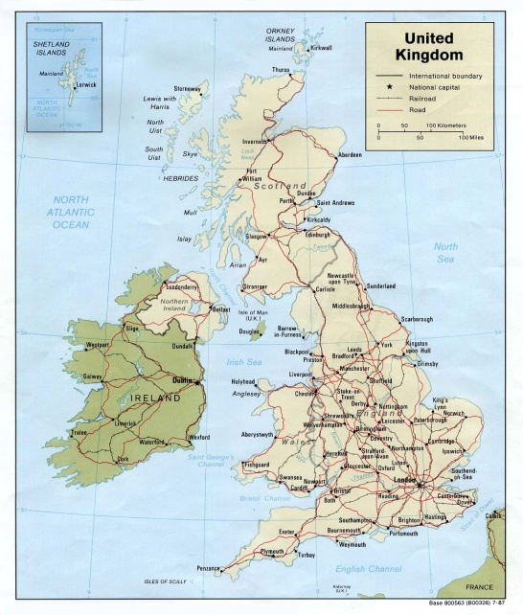
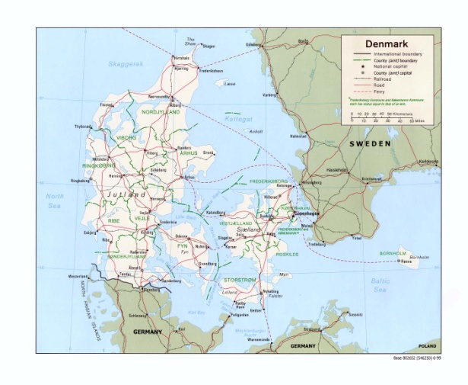
Background
UK
Population: 62m
Land Area: 243,000km
Population Density: 255 people/km
Arable Land: 23%
Agriculture as % of economy: 0.7%
Renewable Energy Consumption: 3%
Biofuels in transport: 3%
Denmark
Population: 5.5m
Land Area: 43,000km
Population Density: 129 people/km
Arable Land: 53%
Agriculture as % of economy: 1.2%
Renewable energy consumption: 20%
Biofuels in transport: 0.2%

Slide 6
Background
Reasons to produce biomass energy
Energy Security
Climate Change Mitigation
Rural Development

Slide 7
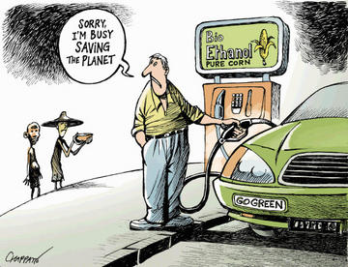
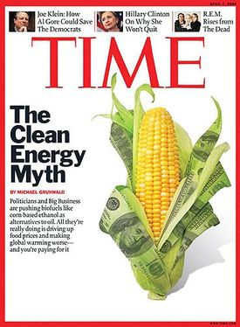
Background
Controversies surrounding
biomass energy: biofuels.
Food versus Fuel
Environmental Impacts
Social Justice

Slide 8
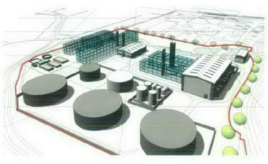
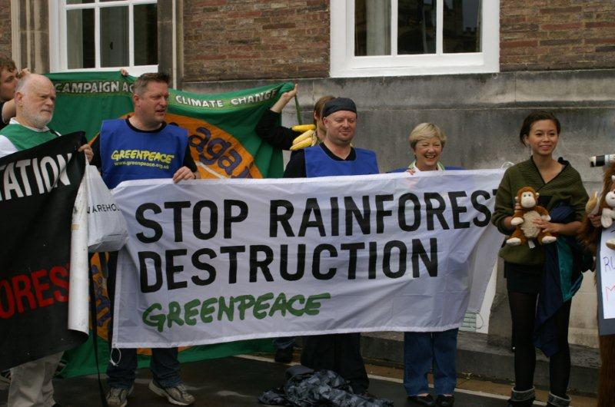
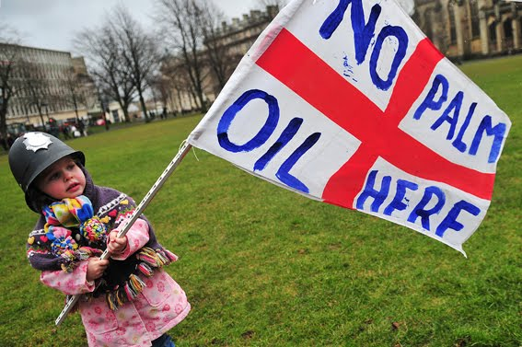
Background
Policy Responses
UK
Slow down targets for biofuels.
Less emphasis on food-based biofuels.
But grant planning permission to biofuels plants.
Denmark
Adopt official targets.
But very little food-based biofuels.
EU: Establish criteria for voluntary sustainability schemes.
All: Fund research into non-food biomass.

Slide 9
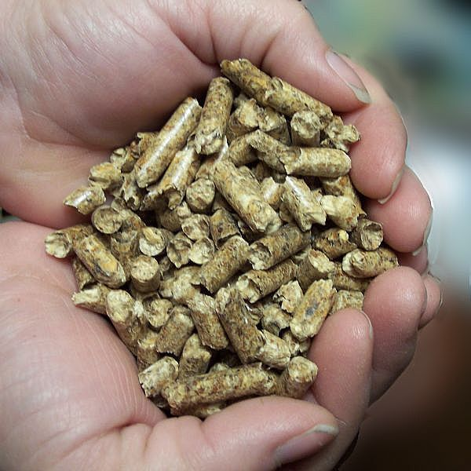
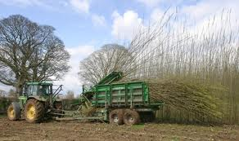
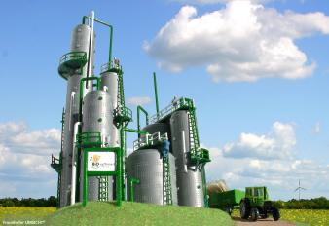
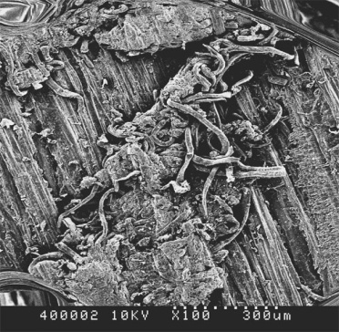
Background
Non-food Biomass
What is it? Wood pellets, crop residues like straw, purpose grown crops like willow, grasses.
How is it used? Currently bioenergy.
“Second generation” biofuels.
Combined use – biorefinery.
How does it work?
Bioenergy: burned.
Biofuels: sugar extracted and fermented into ethanol.
Biorefinery: both.

Slide 10
Background
Non-food biomass – perceived advantages
More environmental friendly: fewer inputs, grow on marginal land – no ILUC.
No food v fuel: not food crops, use marginal land/crop residues.
More efficient and high yielding: higher energy yield/ha, use all parts of crop, GM.

Slide 11
Interests
Use of agricultural land for non-food biomass.
Non-food biomass still uses land. Involves land use change.
Uncertainty in agricultural production systems. How responsible?
Effects on agricultural systems.

Slide 12
Interests
Use of agricultural land for non-food biomass.
Types of land. Marginal land. Other uses. Environmentally vulnerable land.
Production ethic. Productionism. Efficiency.
Thompson (1995) The Spirit of the Soil Routledge London
Produce fuel frugally in a commodities market? Feasible?

Slide 13
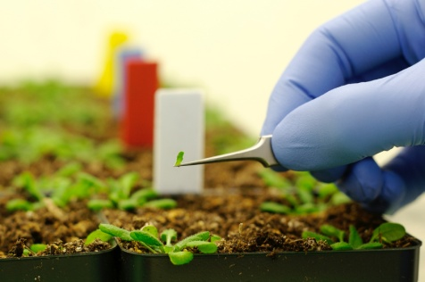
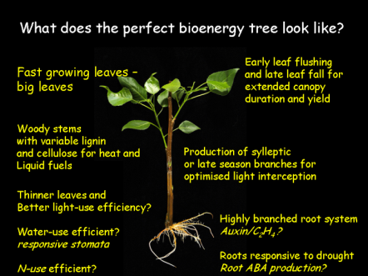


Interests
Land and Technology
GM: discourse of efficiency.
Malthusian technocratic defence of scientific progress.
Philosophical objections: freedom from and control over nature. Ethically problematic.
Practical: doesn’t fix problems and creates new problems.

Slide 14
Interests
Land and Technology
Biomass for energy: natural or technological? “Plants are able to absorb and store solar energy without technological intervention” WGBU (2008) Future Bioenergy and Sustainable Land Use London WGBU
Cyborg crop. “Late twentieth century machines have made thoroughly ambiguous the difference between natural and artificial, mind and body, self-developing and externally designed and many other distinctions that used to apply to organisms and machines.” Haraway (2004) “They Cyborg Manifesto” in Readings in Philosophy of Technology (ed.) Kaplan Oxford Rowman and Littlefield
How metaphorical or literal language of perfection?

Slide 15
Interests
Land and Society
Three policy objectives. Energy security. Environmental accountability.
Short term or long term solution? Other objectives.
Competing uses.

Slide 16
Interests
Land and Society
Why use land for energy? Other uses of land, other technologies, other solutions.
Place for agrarian land ethic in debates about biomass energy? Thompson (2007) “The agricultural ethics of biofuels: a first look” Journal of Agricultural and Environmental Ethics 21: 183-198
More limited resources = greater appreciation? Import way out of problem?

Slide 17
Interests
Overarching Question
What does it mean to use land in an ethical way to produce non-food biomass for energy?
Broad interest in intersection of people, land and technology in relation to biomass energy.
Explore the values implicit in debates and how ethical uncertainty is framed and managed in the governance of biomass energy development.

Slide 18
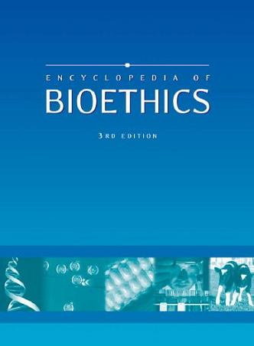
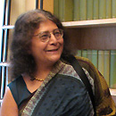
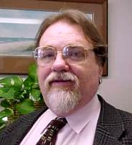
Methodology
Social Sciences and bioethics – how to combine?
Deconstruction and reconstruction
Deconstruction. STS - “analytic process by which scientific claims are disentangled into their material, social and rhetorical components.” Jasanoff, S. (1999) “STS and Public Policy: Getting Beyond Deconstruction” Science Technology and Society (4) :59-72
Deconstruction. Environmental Pragmatism –”method of refuting an interpretation or view of the world by exposing implicit or locally contingent elements of its logic.” Thompson, P. (1996) “Pragmatism and the case of water” in Environmental Pragmatism (eds.) Light, A. and Katz, E. New York, Routledge

Slide 19


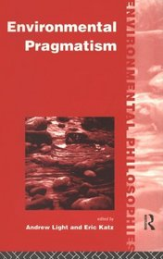
Methodology
Social Sciences and bioethics – how to combine?
Constructivism. STS - “its ultimate aim is to piece things together constructively, combining the heterogeneous elements into richer pictures of complex systems and activities.” Jasanoff, S. (1999) “STS and Public Policy: Getting Beyond Deconstruction” Science Technology and Society (4) :59-72
Reconstruction. Environmental Pragmatism – “Reconstruct a broader and more inclusive community”. “Reconstruct common visions of life and purpose on more honestly social (and hence quite temporary) foundations.” Thompson, P. (1996) “Pragmatism and the case of water” in Environmental Pragmatism (eds.) Light, A. and Katz, E. New York, Routledge

Slide 20
Methodology
Social Sciences and bioethics – how to combine?
Both – emphasis on engaging with policy.
Context dependency.
Framing and ethical analysis.

Slide 21
Methodology
Uncertainties
What does reconstruction look like?
How use theory in environmental pragmatism? Context dependent.
Role of policy.

Slide 22
Empirical Work
Explore the framing of these issues through interviews with:
Scientists.
Industry representatives.
Policy makers and civil society organisations.

Slide 23
Empirical Work
Timetable: 3 work packages, 4 months each, divided between UK and Denmark.
Interviews: Focus groups/workshops/individual interviews.
Access: Through project partners.

Slide 24
Conclusion
Controversial, resource intensive technology.
Interested in intersection of people technology and natural world. Ethical character of biomass production and use.
Pull apart and rebuild issues.

Slide 25
Thank you for your attention
Acknowledgements: Dr. Kate Millar, Dr. Sujatha Raman, Prof. Peter Sandoe, Dr. Christian Gamborg.
University of Nottingham and University of Copenhagen.

