Slide 1
Complex Systems?
D. Chu

Slide 2
Complex? Systems?
D. Chu

Slide 3
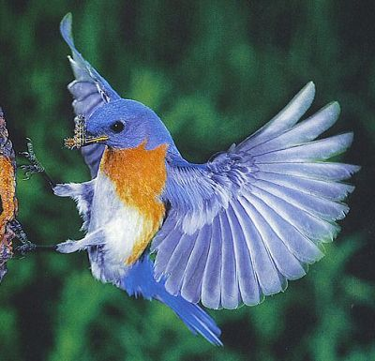
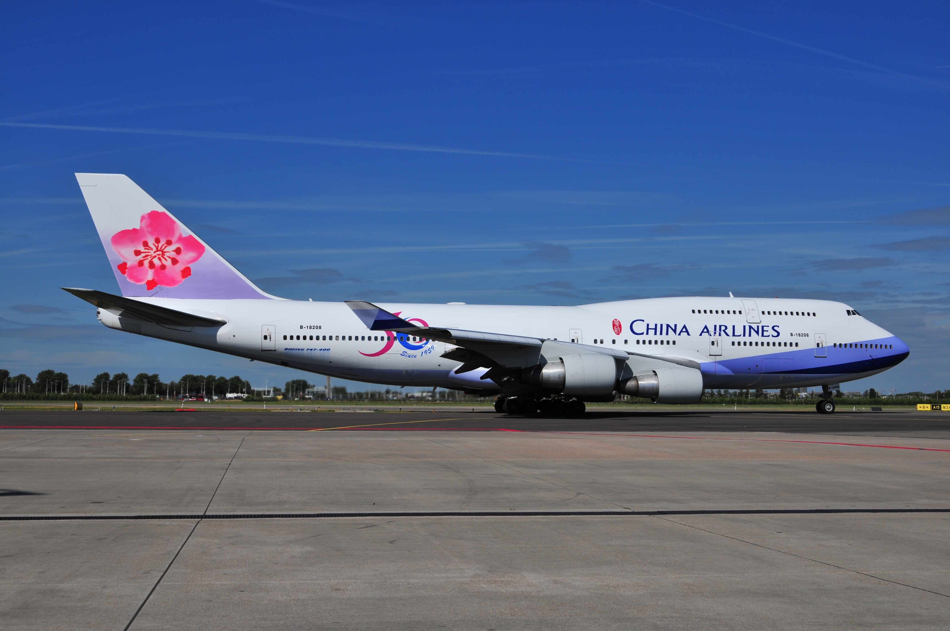
Birds and Jumbo Jets

Slide 4
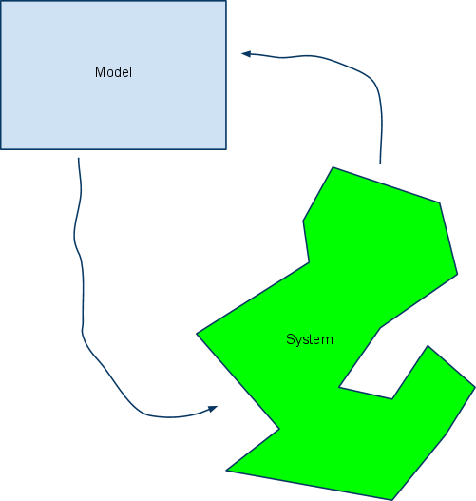

Slide 5
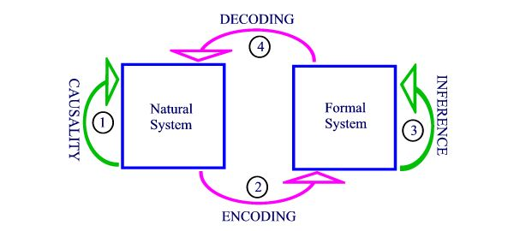
http://www.panmere.com/images/rmodel4.jpg

Slide 6
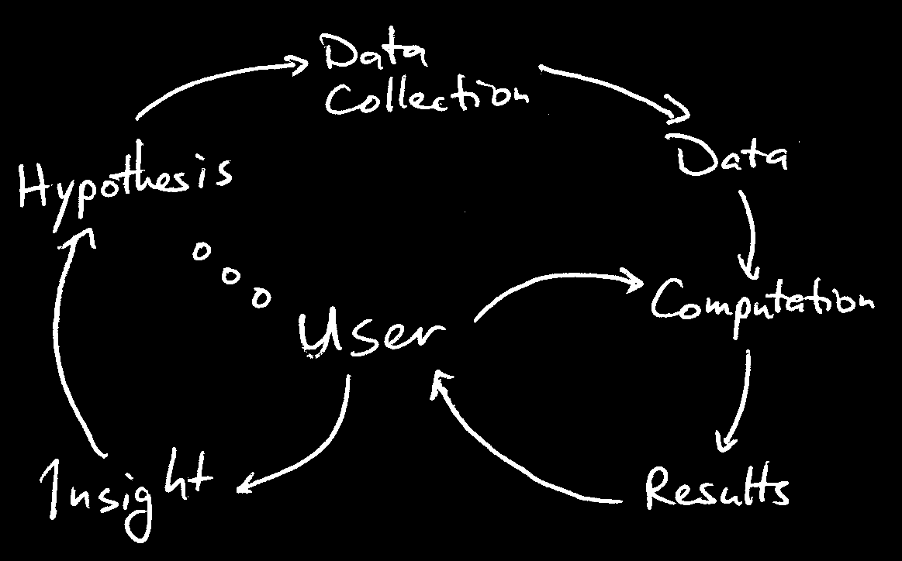
http://web0.tc.cornell.edu/Services/Education/Topics/General/VizTools/Overview.aspx

Slide 7
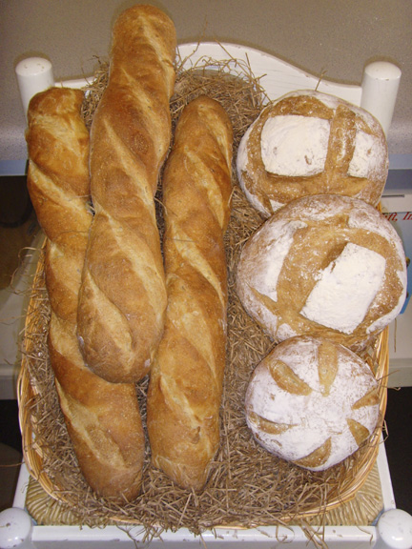
Bakery model of complex systems.

Slide 8
Systems?
The question is of course:
How do we know about a system, if not through models?

Slide 9
Formal models
Mathematics is the language with which God
has written the universe.
-- Galileo Galilei

Slide 10
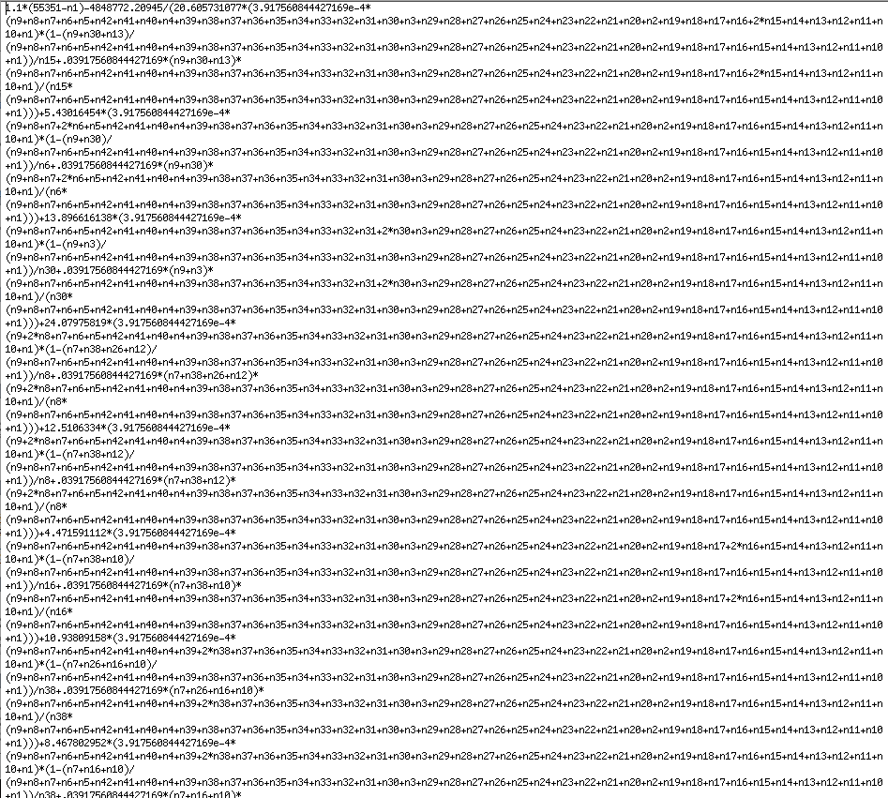

Slide 11
Complexity of the model
1.7 MB (uncompressed)
70 kB (compressed using zip)
16 kB for the script generating equations
About 2 sec. to solve using ASCEND
About 30mins to solve using Matlab

Slide 12
Shortcomings of the model
Considers steady state only.
We want dynamics.

Slide 13
nearFw545a3, c56_6 +n35 -> v56_6_3, 140;
nearRe545a3, v56_6_3-> c56_6 +n35,25.52608726990228;
read546, c56_7 +n32 -> c56_8 + un32, 140;
nearFw546a1, c56_7 +n28 -> v56_7_1, 140;
nearRe546a1, v56_7_1-> c56_7 +n28,25.52608726990228;
nearFw546a2, c56_7 +n31 -> v56_7_2, 140;
nearRe546a2, v56_7_2-> c56_7 +n31,25.52608726990228;
nearFw546a3, c56_7 +n35 -> v56_7_3, 140;
nearRe546a3, v56_7_3-> c56_7 +n35,25.52608726990228;
read547, c56_8 +n32 -> c56_9 + un32, 140;
nearFw547a1, c56_8 +n28 -> v56_8_1, 140;
nearRe547a1, v56_8_1-> c56_8 +n28,25.52608726990228;
nearFw547a2, c56_8 +n31 -> v56_8_2, 140;
nearRe547a2, v56_8_2-> c56_8 +n31,25.52608726990228;
nearFw547a3, c56_8 +n35 -> v56_8_3, 140;
nearRe547a3, v56_8_3-> c56_8 +n35,25.52608726990228;
read548, c56_9 +n32 -> c56_10 + un32, 140;
nearFw548a1, c56_9 +n28 -> v56_9_1, 140;
nearRe548a1, v56_9_1-> c56_9 +n28,25.52608726990228;
nearFw548a2, c56_9 +n31 -> v56_9_2, 140;
nearRe548a2, v56_9_2-> c56_9 +n31,25.52608726990228;
nearFw548a3, c56_9 +n35 -> v56_9_3, 140;
nearRe548a3, v56_9_3-> c56_9 +n35,25.52608726990228;
read549, c56_10 +n32 -> c56_11 + un32, 140;
nearFw549a1, c56_10 +n28 -> v56_10_1, 140;
nearRe549a1, v56_10_1-> c56_10 +n28,25.52608726990228;
nearFw549a2, c56_10 +n31 -> v56_10_2, 140;

Slide 14
Complexity of dynamic model
225 kB (uncompressed)
41 kb (compressed using zip)
Runs overnight on cluster computer using Slepoy’s algorithm.

Slide 15
Complexity and (formal) models
Measuring the size of a component.
Is mainly a technological problem.
“Measures of complexity”

Slide 16
Semantic models
In the beginning was the Word, and the Word was with God, and the Word was God.
--John 1,1

Slide 17
How to do SB
Experiences
Understanding
negotiate
Formal models (outsourced reasoning)

Slide 18
How to do SB
Experiences
Understanding
negotiate
Negotiate, simplify
Experimental System
Formal models (outsourced reasoning)

Slide 19
How to do SB
Pickering’s “Dance of agency”
Experiences
Understanding
negotiate
Negotiate, simplify
Experimental System
Formal models (outsourced reasoning)

Slide 20
How to do SB
Experiences
Understanding
negotiate
Negotiate,simplify
Experimental System
Complexity
Formal models (outsourced reasoning)

Slide 21
How to do SB
Note: There is no “system” in this picture.
The “complexity” here is a property of models
Experiences
Understanding
negotiate
Negotiate,simplify
Experimental System
Complexity
Formal models (outsourced reasoning)

Slide 22
How to do SB
We can identify the system with the result of
the “dance of agency”
Model ----> System
Experiences
Understanding
negotiate
Negotiate,simplify
Experimental System
Complexity
Formal models (outsourced reasoning)

Slide 23
What if….
Experiences
Understanding
negotiate
Experimental System
negotiate
Complexity
Formal models (outsourced reasoning)

Slide 24
What if….
Experiences
Understanding
??????
????
Formal models (outsourced reasoning)

Slide 25
What if….
Experiences
Understanding
Model 79
Model 2
Model 187
Model 1

Slide 26
Which model is right?

Slide 27
Which model is right?
Depends on….its purpose.

Slide 28
Causes of complexity
Radical openness
Contextuality
Heterogeneity

Slide 29
Examples:
Models of Gene expression

Slide 30
Gene Expression

Slide 31
Gene expression

Slide 32
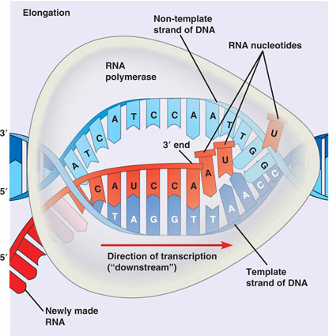
Gene expression

Slide 33
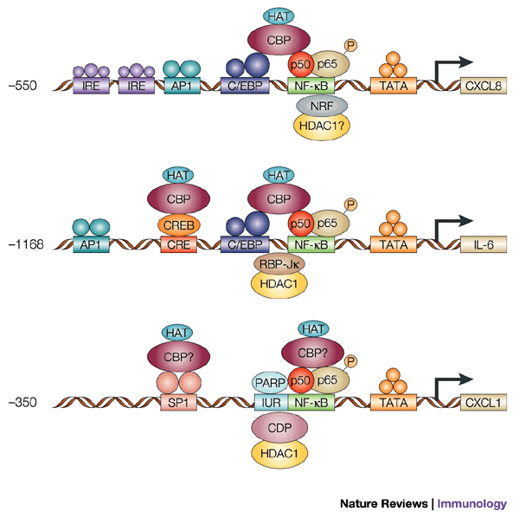
Gene expression

Slide 34
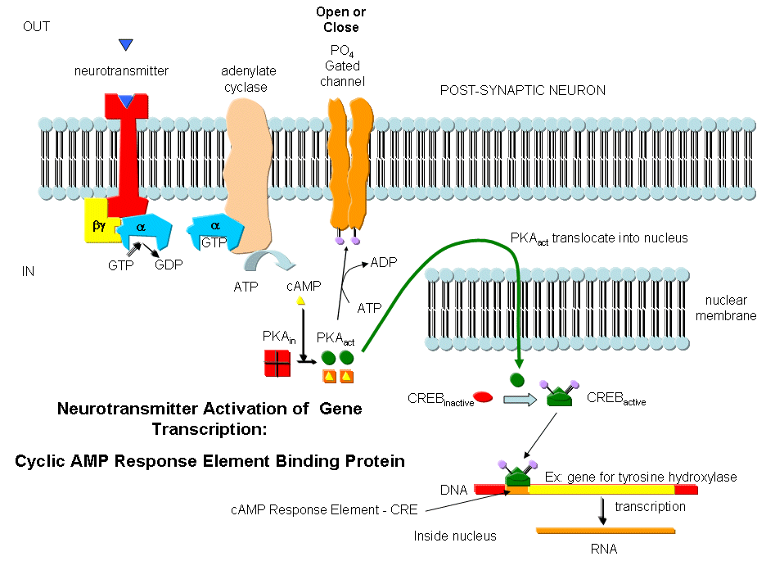
Gene expression

Slide 35
Complexity yes or no?
What kinds of problems/research questions allow ``stable’’ models?
Laboratory system is helpful.
A problem that can be limited (“I am interested in translation efficiency in yeast.”)
The criteria as to what counts as an interesting problem and what counts as a solution ultimately depend on social conventions such as:
  Paradigms
  what counts as an interesting problem in the community
  what counts as a solution (SB is a case in point)

Slide 36
Causes of complexity
Radical openness
  There are no systems and sich.
  Hence there are no natural boundaries to systems.
  Every model must define pragmatic system boundaries.
  Sometimes this works sometimes it does not.
Contextuality.
  Models will intersect.
  They have different representations of the same “conceptual entities”.
    DNA as string of binding sites
    DNA as a information carrier
    DNA as code.
  Side effects.

Slide 37
Conclusion
Complexity is not a property of systems an sich.
Systems depend on models (semantic and formal) and not the other way round.
Complexity is depends on modelling purpose.

