Slide 1
Fuel from the farm – exploring ethical issues raised by the use of agricultural biomass in the UK and Denmark
Orla Shortall
University of Nottingham,
University of Copenhagen.

Slide 2
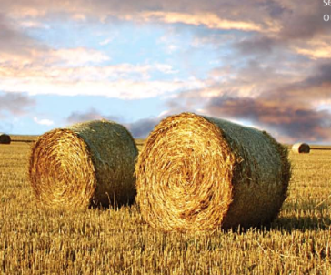

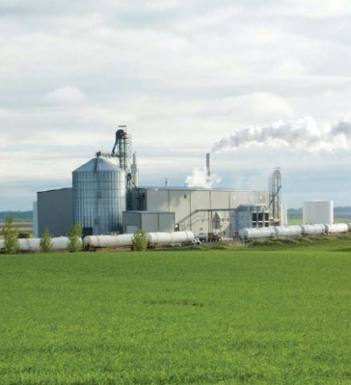
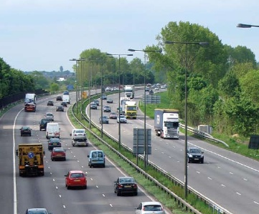
Introduction
Background to project
Previous analysis
Research questions
Methods
Findings
Conclusion

Slide 3
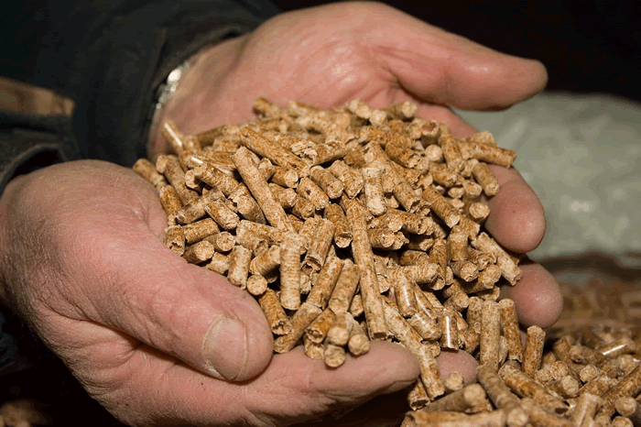

Biomass
Anything living or previously living.
Used in heat, power, transport.
Waste, forestry, agricultural produce.

Slide 4
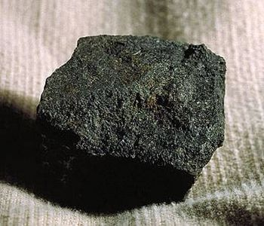
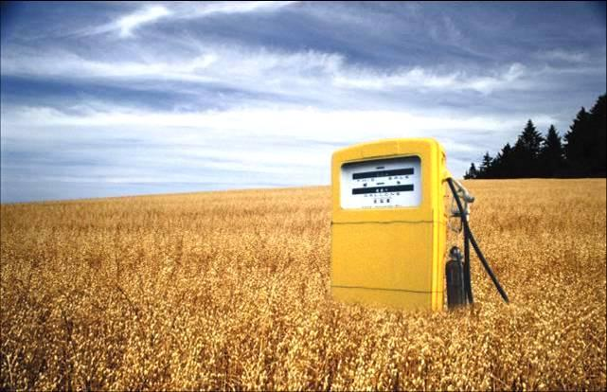
Biomass
Reasons for using it:
Energy security
Climate change mitigation
Rural development

Slide 5
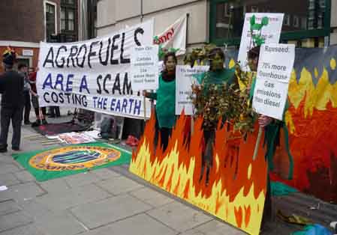
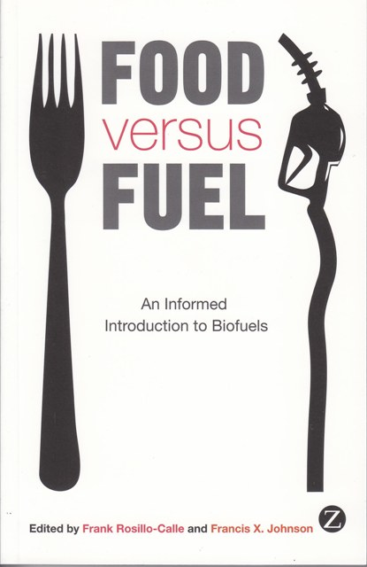
Biomass
Controversies:
Environmental impacts
Food versus fuel
Global justice

Slide 6
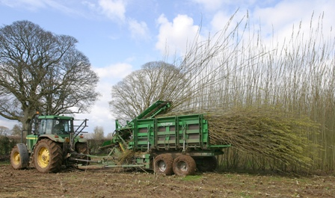
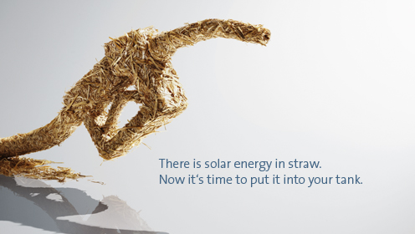
Biomass
Ways forward:
“Second generation” biofuels
Marginal land
Fewer environmental impacts
High tech processing

Slide 7
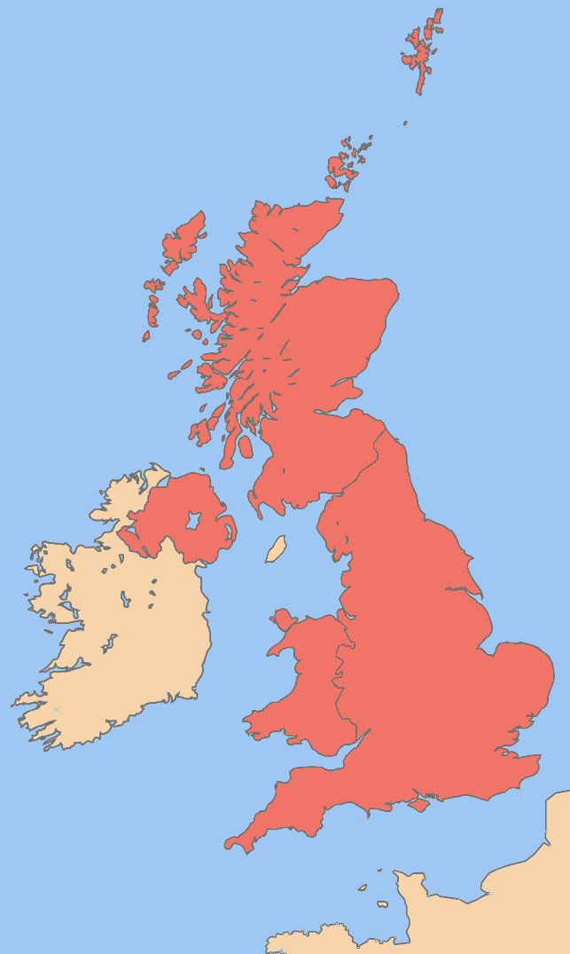
UK
Population: 62m
Area: 244,000km2
Energy from renewables: 3% (DECC 2011a)
Biofuels in transport: 3% (DECC 2011a)
Target energy consumption 2020: 15% (DECC 2011b)
DECC (2011a) Digest of United Kingdom Energy Statistics, DECC, London.
DECC (2011b) Renewable Energy Roadmap, DECC, London

Slide 8
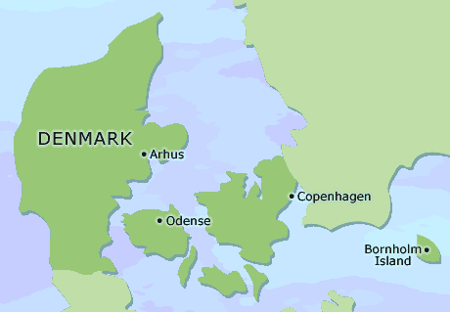
Denmark
Population: 5.5m
Area: 43,000km2
Energy from renewables: 22% (Danish Energy Agency 2011)
Biofuels in transport: 0.2% (Danish Energy Agency 2011)
Target energy consumption 2020: 30% (Danish Government 2011)
Danish Energy Agency (2011) Energy Statistics 2010, Danish Energy Agency, Copenhagen.
Danish Government (2011) Energy Strategy 2050, Danish Government, Copenhagen.

Slide 9
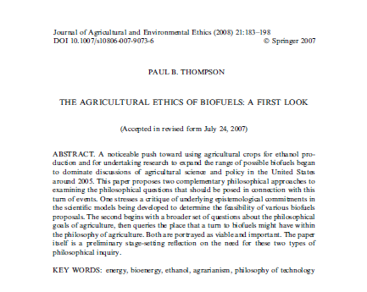

Previous analysis
Paul Thompson (2008): biofuels are too industrial.
Raman and Mohr (in press): objections to biofuels based on objections to global, industrial agriculture.

Slide 10
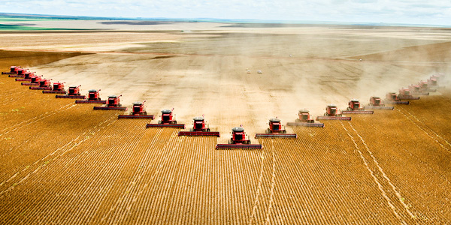
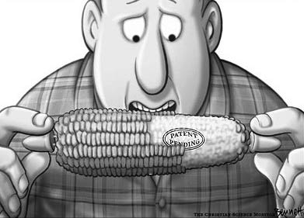
Previous analysis
Industrial agriculture: high-tech, intensive, large scale, productionist, efficient.
”And he gave it for his opinion, that whoever could make two ears of corn, or two blades of grass, to grow upon a spot of ground where only one grew before, would deserve better of mankind, and do more essential service to his country, than the whole race of politicians put together.” – Jonathan Swift.

Slide 11
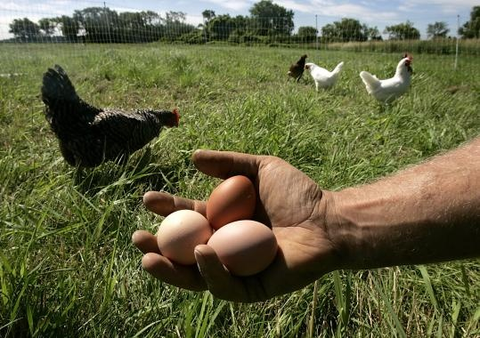
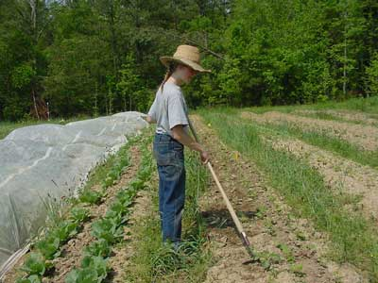
Previous analysis
Agrarian agriculture: lower-tech, extensive, small scale, local.
“There are two spiritual dangers in not owning a farm. One is the danger of supposing that breakfast comes from the grocery, and the other that heat comes from the furnace.” Aldo Leopold.

Slide 12

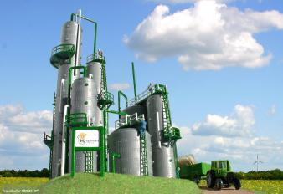
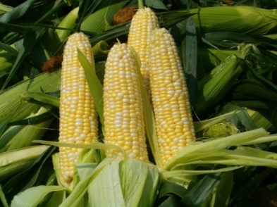
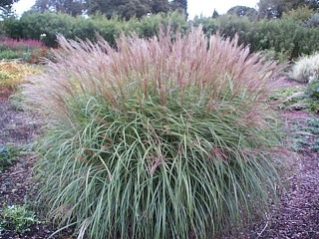
Research questions
How is perennial energy crop production and crop residue use seen by key stakeholders: as industrial or agrarian or both or neither?
Is “second generation” a different model of production? In terms of:
- Land use
Production methods

Slide 13
Methods
Interviews with academics, regulators, civil society (CS), industry in UK and Denmark ≈26.
Document analysis – 60 documents from above groups.
Work completed so far – half document analysis, several interviews.

Slide 14
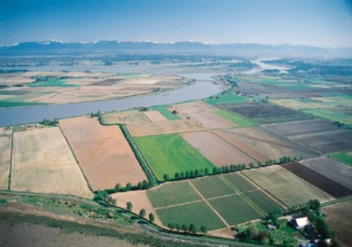
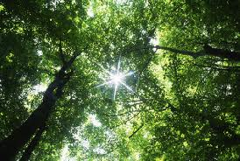
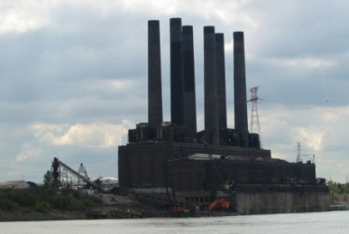
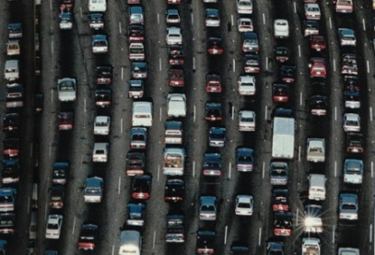
Findings
Overview:
Differing aims for biomass.
Danish documents question demand.
Mostly industrial themes in academic literature.
“Agrarian” themes among UK CS – developing countries.
And Danish academic.

Slide 15
Findings
Land
Land ≠place.
Reification of “land use” and “land use change”.
“Land use change” and “land use” are bad.
Top down decision making.
“Available” and “suitable” land.

Slide 16
Findings
Marginal land.
More common in UK context.
Evolution and ambiguity of the term.
Not widely used in modelling.
Does it mean anything?

Slide 17
Findings
Technology and production
Yield increases will free up land.
Technology makes “available” and “suitable” land negotiable.
Crops as technology.
Efficiency universally promoted.

Slide 18
Findings
Agrarian themes
UK CS documents.
Lack of UK focused agrarian themes.
Danish academic documents.
What’s behind discourse of local, low tech?

Slide 19
Conclusion
Hypotheses working on.
There is something interesting about discourse of local production – what’s behind it.
Mostly industrial themes.
Grand conceptions are different – diet energy crops.
Land use is bad. Address production not consumption.

Slide 20
Conclusion
What next?
Finish data collection and analysis.
Go into more depth on industrial and agrarian conceptions of agriculture.
Narrow down themes and analysis. Focus on what’s unique to biofuels?
How are discourses of marginal land and efficiency/intensification related?

Slide 21
Conclusion
Questions.
How to leave things out? Interesting ≠ important. My interests ≠ preoccupations in the documents.
Already analysis in different areas on intensification freeing up land, efficiency in agriculture.

Slide 22
Thank you for your attention
Acknowledgements: Dr. Kate Millar, Dr. Sujatha Raman, Prof. Peter Sandøe, Dr. Christian Gamborg.

